Slide 1
Intercharm, Kiev
22-September-2016
Notes:
Message:
To show that we co-exist with oleochemical products. We may not know that we use these products everyday in more ways than one but we do. We depend on such products more than we think.
Image:
Images inside the word “LIVES” showing KLK OLEO products’ applications.
Script:
Touching life in many ways….why do we say that ?
Many people may not be aware that KLK OLEO products touch their life in many ways. From the colourful packaging we see in supermarkets today to the things we use daily like soaps and shampoo, it is all linked to the palm oil fruits and palm oil – the very things KLK OLEO produces.
This shows that palm oil plays a huge part in our lives from the little things to the bigger ones.
It is indeed touching life in many ways because these KLK OLEO products are being used every single day and we depend on them more than you can imagine.

Slide 2
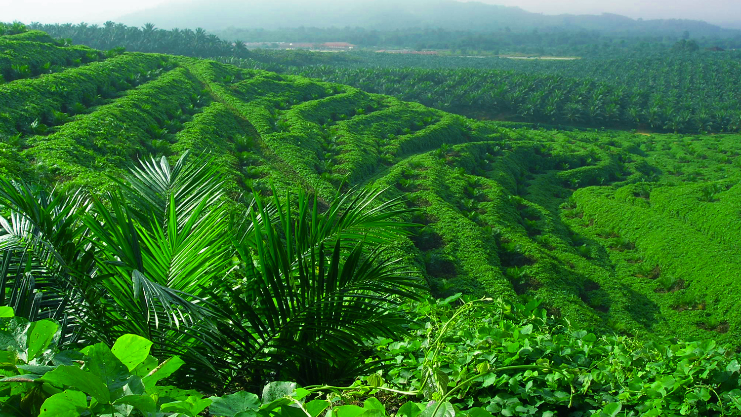
From Plant…
Notes:
Message:
This slide is at a glance to show how KLK OLEO can be part of our everyday lives, and KLK OLEO product beneficial to our life.
Image:
Examples of consumers product/industrial uses that may contain ingredient produced by KLK OLEO.
Caption:
List of some of KLK OLEO Product Brand Name (but not all) and their functionality in end products. These brands include products produced from Malaysia, China & Europe manufacturing facilities. Refer to note in last slide for detail about the respective brand.
Script:
The first thing in the morning from when we wake up and brush our teeth, take a shower, apply makeup, eat breakfast, did you know that we are actually using ingredients like sweetener, emulsifiers, foam booster, energy source in our personal care products?
From the moment we step out of the house to travel to work and school in our methods of transportation, we are using biodiesel as biofuel. When we reach the office, supplies like printer, computers and fax machines made from plastics, may also contain ingredients made from KLK OLEO products.
At night, the cleansing agent keeps our face clean; when we use body lotion to massage the day’s stress away, the products contain emollient to keep our skin moist.
As you can see, all the products mentioned contain ingredients from KLK OLEO to make us part of your everyday lives.

Slide 3
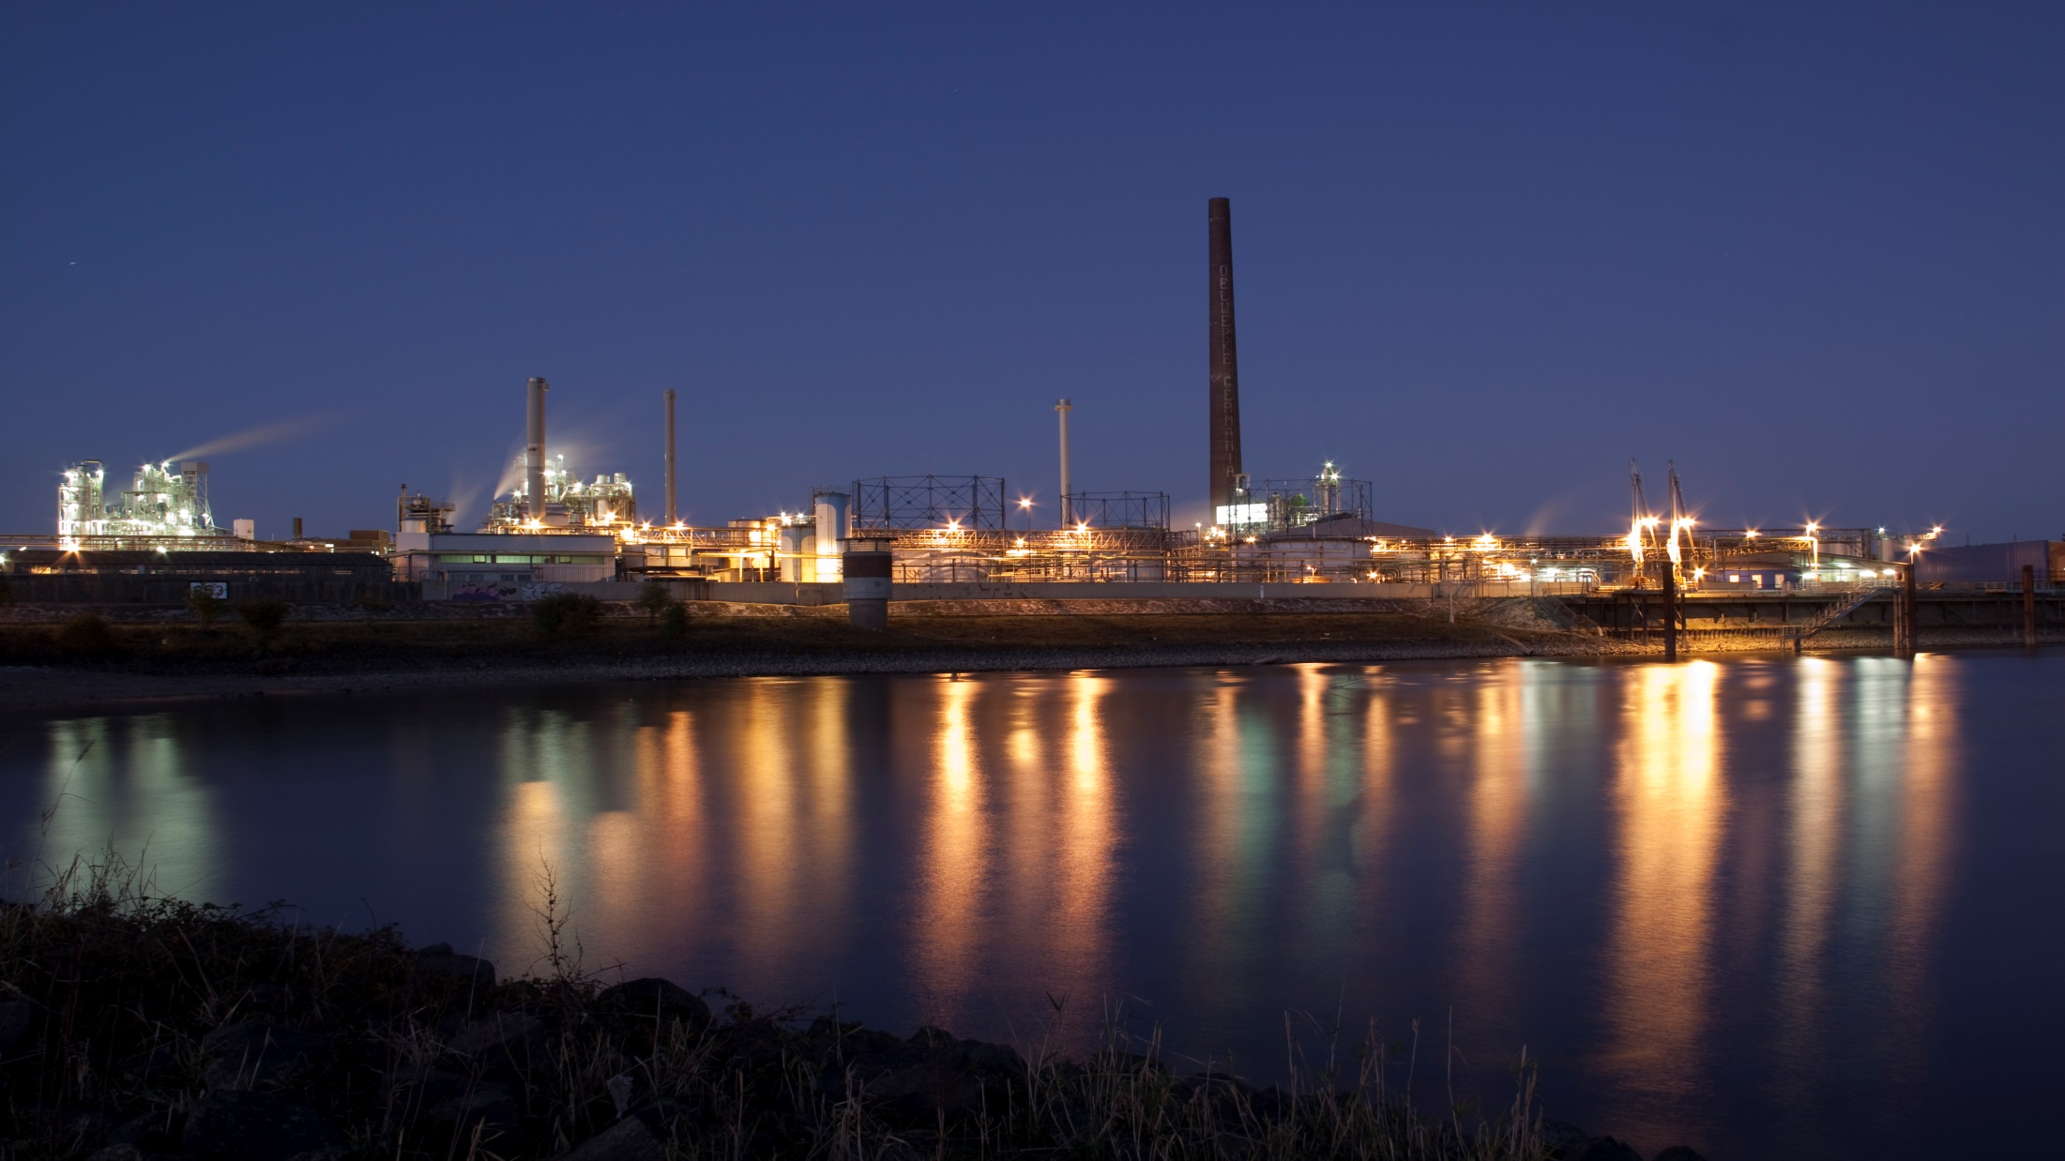
… to first class raw materials…
Notes:
Message:
This slide is at a glance to show how KLK OLEO can be part of our everyday lives, and KLK OLEO product beneficial to our life.
Image:
Examples of consumers product/industrial uses that may contain ingredient produced by KLK OLEO.
Caption:
List of some of KLK OLEO Product Brand Name (but not all) and their functionality in end products. These brands include products produced from Malaysia, China & Europe manufacturing facilities. Refer to note in last slide for detail about the respective brand.
Script:
The first thing in the morning from when we wake up and brush our teeth, take a shower, apply makeup, eat breakfast, did you know that we are actually using ingredients like sweetener, emulsifiers, foam booster, energy source in our personal care products?
From the moment we step out of the house to travel to work and school in our methods of transportation, we are using biodiesel as biofuel. When we reach the office, supplies like printer, computers and fax machines made from plastics, may also contain ingredients made from KLK OLEO products.
At night, the cleansing agent keeps our face clean; when we use body lotion to massage the day’s stress away, the products contain emollient to keep our skin moist.
As you can see, all the products mentioned contain ingredients from KLK OLEO to make us part of your everyday lives.

Slide 4
… to products we use every day
Notes:
Message:
This slide is at a glance to show how KLK OLEO can be part of our everyday lives, and KLK OLEO product beneficial to our life.
Image:
Examples of consumers product/industrial uses that may contain ingredient produced by KLK OLEO.
Caption:
List of some of KLK OLEO Product Brand Name (but not all) and their functionality in end products. These brands include products produced from Malaysia, China & Europe manufacturing facilities. Refer to note in last slide for detail about the respective brand.
Script:
The first thing in the morning from when we wake up and brush our teeth, take a shower, apply makeup, eat breakfast, did you know that we are actually using ingredients like sweetener, emulsifiers, foam booster, energy source in our personal care products?
From the moment we step out of the house to travel to work and school in our methods of transportation, we are using biodiesel as biofuel. When we reach the office, supplies like printer, computers and fax machines made from plastics, may also contain ingredients made from KLK OLEO products.
At night, the cleansing agent keeps our face clean; when we use body lotion to massage the day’s stress away, the products contain emollient to keep our skin moist.
As you can see, all the products mentioned contain ingredients from KLK OLEO to make us part of your everyday lives.

Slide 5
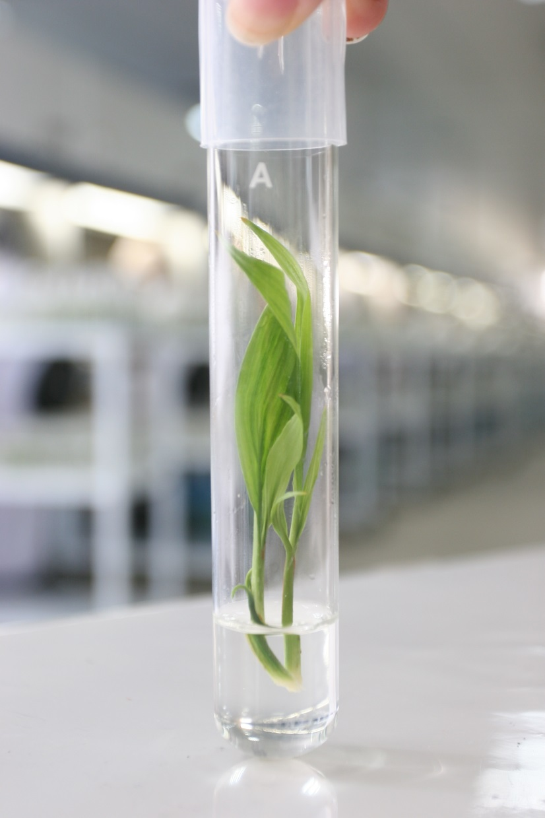
Let’s start at the beginning
KLK is one of the world’s leading oleochemical companies with a strong base in plantations.
From the Palm tree to our high end products, KLK covers the whole supply chain.
Notes:
Message:
This slide is at a glance to show how KLK OLEO can be part of our everyday lives, and KLK OLEO product beneficial to our life.
Image:
Examples of consumers product/industrial uses that may contain ingredient produced by KLK OLEO.
Caption:
List of some of KLK OLEO Product Brand Name (but not all) and their functionality in end products. These brands include products produced from Malaysia, China & Europe manufacturing facilities. Refer to note in last slide for detail about the respective brand.
Script:
The first thing in the morning from when we wake up and brush our teeth, take a shower, apply makeup, eat breakfast, did you know that we are actually using ingredients like sweetener, emulsifiers, foam booster, energy source in our personal care products?
From the moment we step out of the house to travel to work and school in our methods of transportation, we are using biodiesel as biofuel. When we reach the office, supplies like printer, computers and fax machines made from plastics, may also contain ingredients made from KLK OLEO products.
At night, the cleansing agent keeps our face clean; when we use body lotion to massage the day’s stress away, the products contain emollient to keep our skin moist.
As you can see, all the products mentioned contain ingredients from KLK OLEO to make us part of your everyday lives.

Slide 6
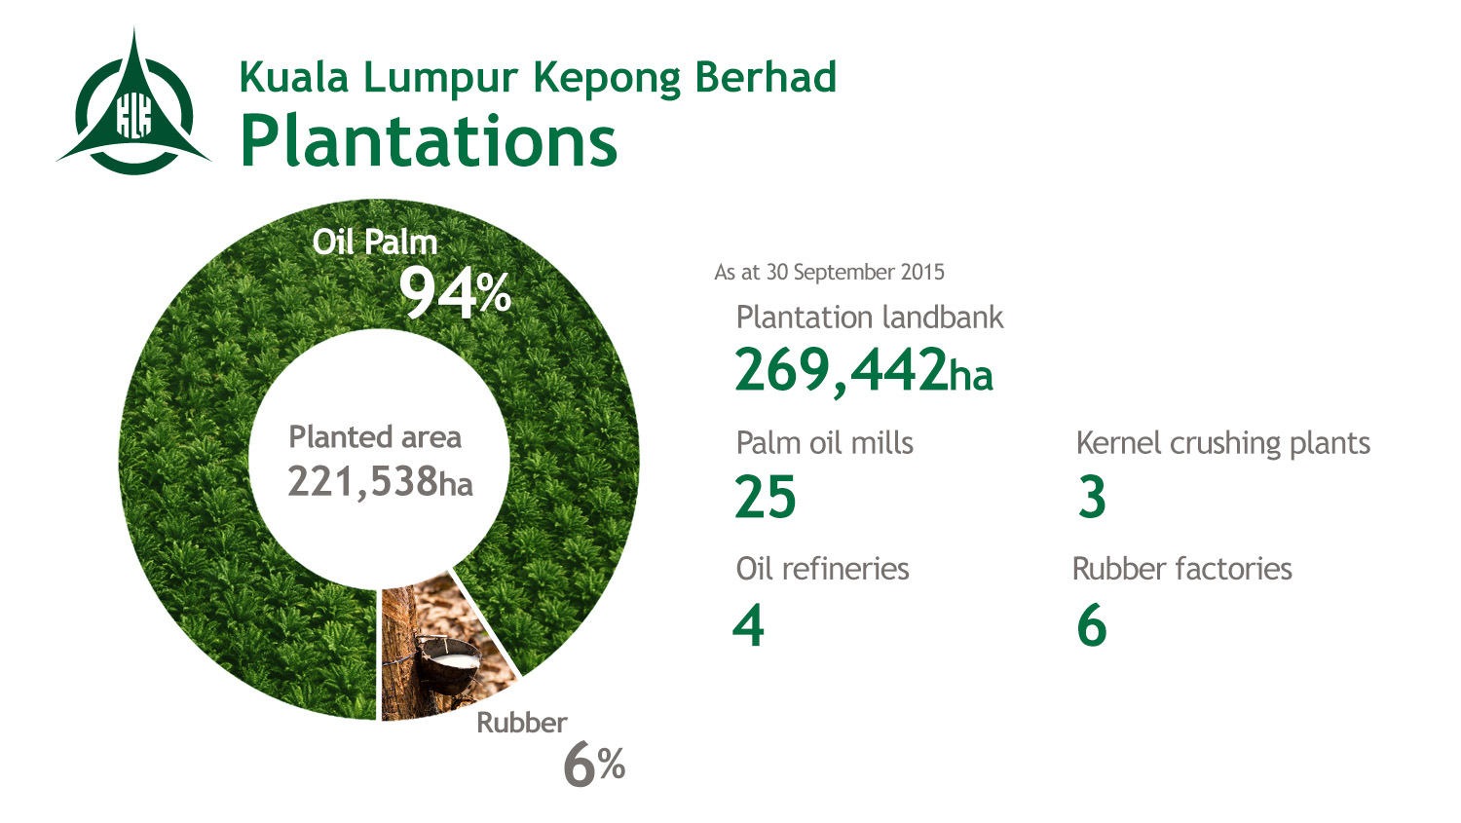
Notes:
Message:
KLK plantation overview
Image:
To show oil palm and rubber pictures where oil palm is KLK’s core business and rubber is secondary.
Figure:
Will be updated every 6months.
Palm Oil Mills
W M’sia (8):
(Kedah)-Batu Lintang ; (Perak)-Changkat Chermin ; (Selangor)- Tuan Mee, Changkat Asa ; (N.Sembilan)-Jeram Padang;
(Johor)- Kekayaan, Paloh ; (Kelantan)-Pasir Gajah
E M’sia (6)
(Sabah)-Pangeran, Tundong (2 mills), Bornion, Rimmer, Lungmanis
Indonesia (11)
(Belitung Island)-Perkasa, Parit Sembada, SWP; (Sumatra)- Mandau, Nilo (2mills), Sekarbumi Alamlestari, Gohor Lama, Padang Brahrang;
(Kalimantan)-Hutan Hijau Mas
Kernel Crushing Plants
E Msia : (Sabah)-KLK Premier Oils
Indonesia : (Sumatra)-Mandau, Belitung
Oil Refineries
W Msia : (Johor)-KLK Edible Oils
E Msia : (Sabah)- KLK Premier Oils
Indonesia : (Belitung)- Steelindo Wahana Perkasa; (Sumatra)- Mandau
Rubber Factories
W Msia : (Selangor)-Changkat Asa; (N. Sembilan)-Jeram Padang; (Johor)- Voules; (Pahang)-Selborne; (Kelantan)-Kuala Gris, Kerilla
Script:
As for our upstream plantation, as of 30 September 2015, we have plantation land bank of 221,538 hectare, 94% of the planted area is dedicated to oil palm estates and the other 6% for rubber plantations.
The group has 25 mills (8 in the peninsular, 6 in east Malaysia and 11 located in Indonesia), 6 rubber factories, 3 kernel crushing plants and 5 oil refineries altogether.

Slide 7
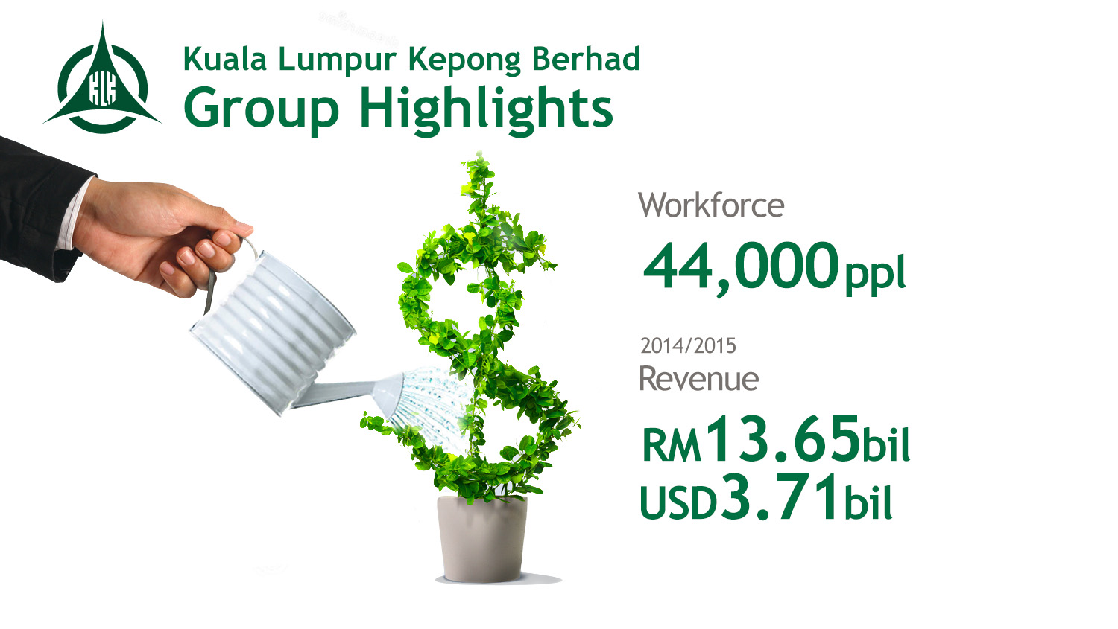
Notes:
Message:
Overview KLK performance - Strong financial statements
Figure:
Yearly update
Script :
In year 2014/2015, KLK group has managed to garner a revenue of RM13.65 bil (USD3.71 bil) with a workforce of 44,000 employees worldwide. Of this, 40,000 are from Malaysian & Indonesian plantation.
***** (For your own info)
Year 2014/2015
Group Revenue : RM 13.65bil (USD 3.71bil)
Plantations : RM bil (USD bil)
Manufacturing : RM bil (USD bil)
Property : RM mil (USD mil)
Other : RM mil (USD mil)
Total Employees : 44,000
Plantation (M’sie & Indonesia) : ~40,000
Manufacturing : ~3000 (includes foreign-based company)
Others : ~1000 (including Liberia Plantation)
Year 2013/2014
Group Revenue : RM 11.13bil (USD 3.38bil)

Slide 8
Notes:
Message:
To show that KLK OLEO is capable to meet the market demand with consistent supply from its multiple supply sites
Image:
To give real visual of all KLK OLEO manufacturing facilities.
Caption:
Plant name by country
Special Note:
“KLK Emmerich (Dusseldorf site)” is name given for newly acquired Emery Oleochemical GmbH Plant
Script:
Our products are produced from 14 manufacturing sites in locations like Malaysia, Indonesia, China, Switzerland, Germany, Netherlands, Belgium and Switzerland as shown in this slide.
With our multiple supply sites from Malaysia, China & Europe, we believe we can consistently supply to meet the market demand.
Special Note
On 26 May 2015, KLK Emmerich GmbH, has entered into a conditional Asset Purchase Agreement (“APA”) to acquire Emery GmbH’s plant, where it will complement KLK Group’s existing fatty acids and glycerine business and will enable it to diversify into the tallow-based market. Besides, KLK will also acquire both the production know-how and trade name for Triacetin products to enhance KLK’s worldwide presence and positioning.

Slide 9
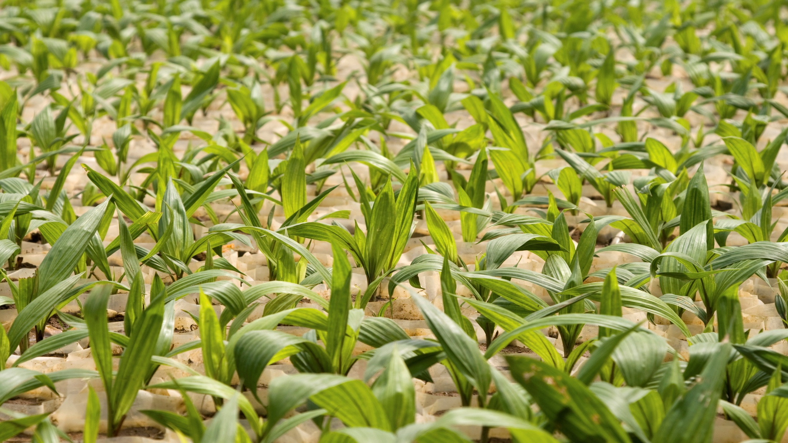
At the plantation
The young plants are nursed
for approximately 1 year
Notes:
Message:
This slide is at a glance to show how KLK OLEO can be part of our everyday lives, and KLK OLEO product beneficial to our life.
Image:
Examples of consumers product/industrial uses that may contain ingredient produced by KLK OLEO.
Caption:
List of some of KLK OLEO Product Brand Name (but not all) and their functionality in end products. These brands include products produced from Malaysia, China & Europe manufacturing facilities. Refer to note in last slide for detail about the respective brand.
Script:
The first thing in the morning from when we wake up and brush our teeth, take a shower, apply makeup, eat breakfast, did you know that we are actually using ingredients like sweetener, emulsifiers, foam booster, energy source in our personal care products?
From the moment we step out of the house to travel to work and school in our methods of transportation, we are using biodiesel as biofuel. When we reach the office, supplies like printer, computers and fax machines made from plastics, may also contain ingredients made from KLK OLEO products.
At night, the cleansing agent keeps our face clean; when we use body lotion to massage the day’s stress away, the products contain emollient to keep our skin moist.
As you can see, all the products mentioned contain ingredients from KLK OLEO to make us part of your everyday lives.

Slide 10
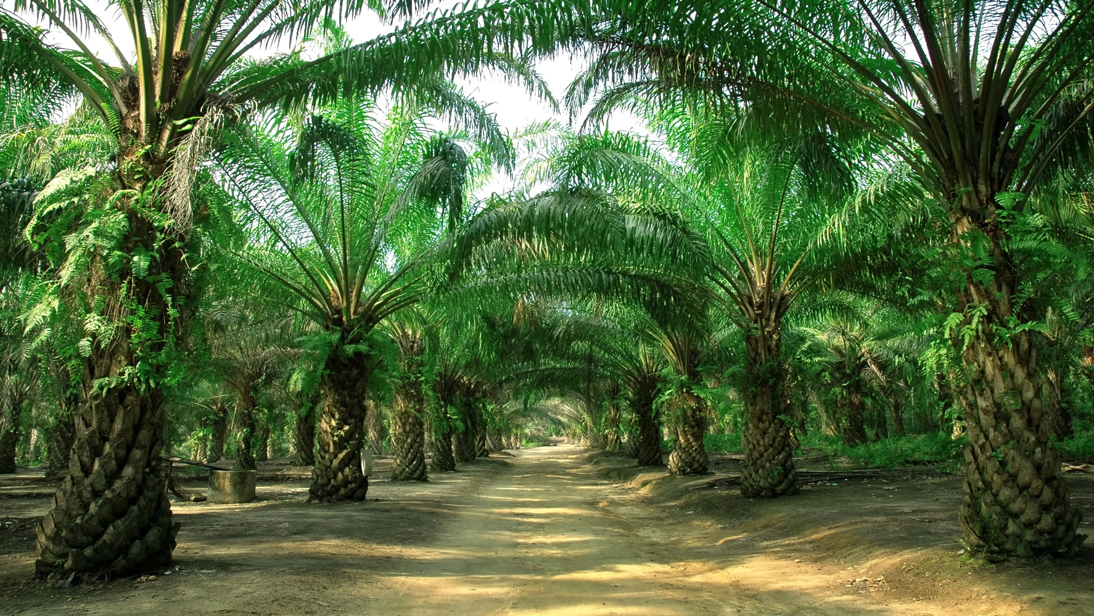
An Oil Palm is productive after about three years
And is most productive typically between year 7 and 18
The Oil Palm is one of the most efficient commercial oil crops
The yield is about 3,6 MT/ha/yr
Rapeseed is around 0,6 MT/ha/yr
Soy bean is around 0,4 MT/ha/yr
And grown to adult palm trees
Notes:
Message:
This slide is at a glance to show how KLK OLEO can be part of our everyday lives, and KLK OLEO product beneficial to our life.
Image:
Examples of consumers product/industrial uses that may contain ingredient produced by KLK OLEO.
Caption:
List of some of KLK OLEO Product Brand Name (but not all) and their functionality in end products. These brands include products produced from Malaysia, China & Europe manufacturing facilities. Refer to note in last slide for detail about the respective brand.
Script:
The first thing in the morning from when we wake up and brush our teeth, take a shower, apply makeup, eat breakfast, did you know that we are actually using ingredients like sweetener, emulsifiers, foam booster, energy source in our personal care products?
From the moment we step out of the house to travel to work and school in our methods of transportation, we are using biodiesel as biofuel. When we reach the office, supplies like printer, computers and fax machines made from plastics, may also contain ingredients made from KLK OLEO products.
At night, the cleansing agent keeps our face clean; when we use body lotion to massage the day’s stress away, the products contain emollient to keep our skin moist.
As you can see, all the products mentioned contain ingredients from KLK OLEO to make us part of your everyday lives.

Slide 11
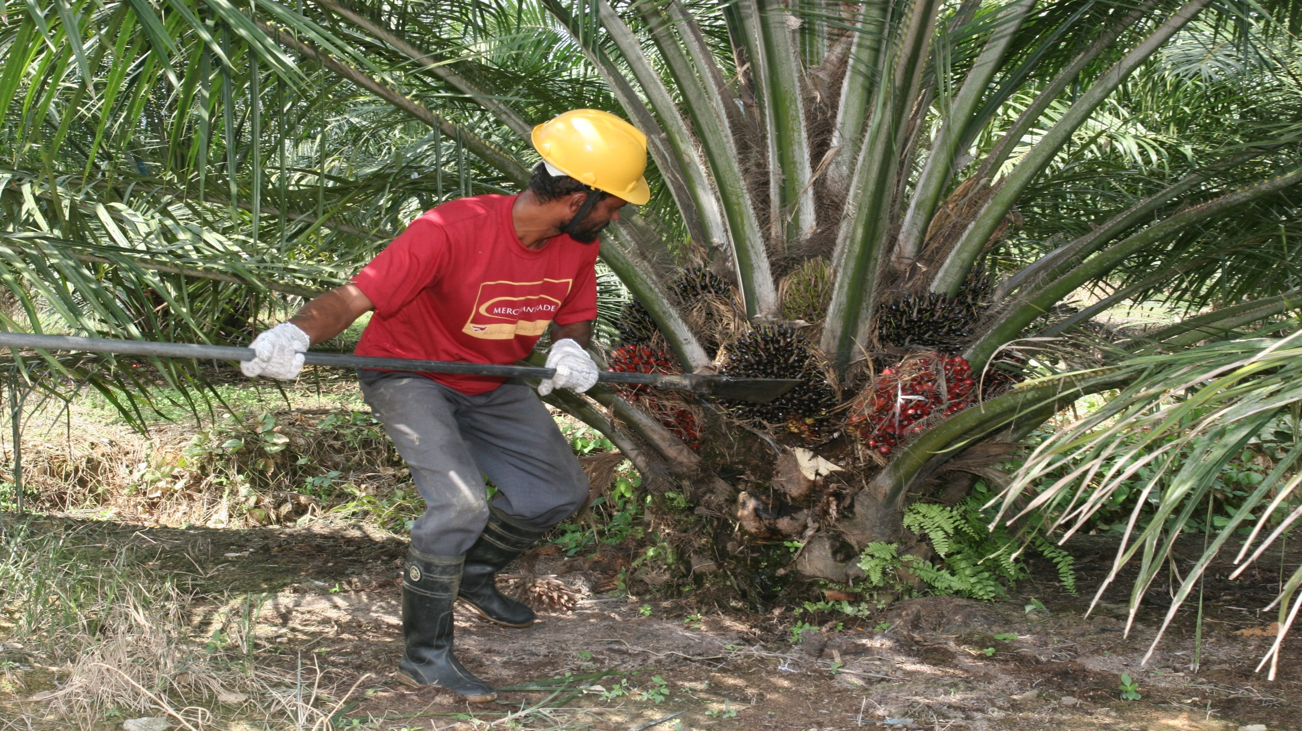
KLK harvests about 4 million MT of fruit bunches per year
Harvesting is done by hand
Notes:
Message:
This slide is at a glance to show how KLK OLEO can be part of our everyday lives, and KLK OLEO product beneficial to our life.
Image:
Examples of consumers product/industrial uses that may contain ingredient produced by KLK OLEO.
Caption:
List of some of KLK OLEO Product Brand Name (but not all) and their functionality in end products. These brands include products produced from Malaysia, China & Europe manufacturing facilities. Refer to note in last slide for detail about the respective brand.
Script:
The first thing in the morning from when we wake up and brush our teeth, take a shower, apply makeup, eat breakfast, did you know that we are actually using ingredients like sweetener, emulsifiers, foam booster, energy source in our personal care products?
From the moment we step out of the house to travel to work and school in our methods of transportation, we are using biodiesel as biofuel. When we reach the office, supplies like printer, computers and fax machines made from plastics, may also contain ingredients made from KLK OLEO products.
At night, the cleansing agent keeps our face clean; when we use body lotion to massage the day’s stress away, the products contain emollient to keep our skin moist.
As you can see, all the products mentioned contain ingredients from KLK OLEO to make us part of your everyday lives.

Slide 12
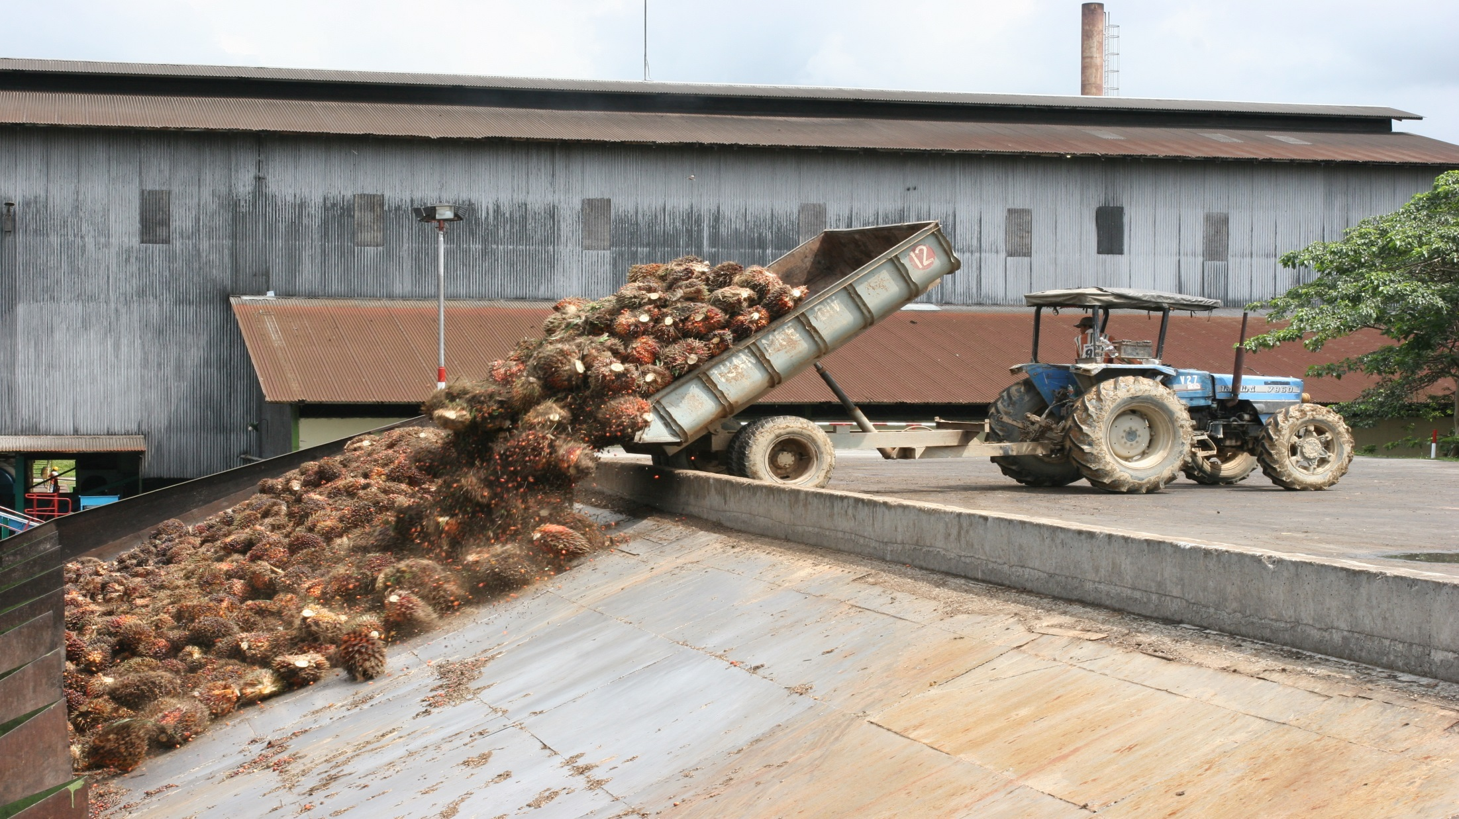
Fruit bunches are unloaded, the oil is extracted from the Mesocarp and the Palm Kernels.
Notes:
Message:
This slide is at a glance to show how KLK OLEO can be part of our everyday lives, and KLK OLEO product beneficial to our life.
Image:
Examples of consumers product/industrial uses that may contain ingredient produced by KLK OLEO.
Caption:
List of some of KLK OLEO Product Brand Name (but not all) and their functionality in end products. These brands include products produced from Malaysia, China & Europe manufacturing facilities. Refer to note in last slide for detail about the respective brand.
Script:
The first thing in the morning from when we wake up and brush our teeth, take a shower, apply makeup, eat breakfast, did you know that we are actually using ingredients like sweetener, emulsifiers, foam booster, energy source in our personal care products?
From the moment we step out of the house to travel to work and school in our methods of transportation, we are using biodiesel as biofuel. When we reach the office, supplies like printer, computers and fax machines made from plastics, may also contain ingredients made from KLK OLEO products.
At night, the cleansing agent keeps our face clean; when we use body lotion to massage the day’s stress away, the products contain emollient to keep our skin moist.
As you can see, all the products mentioned contain ingredients from KLK OLEO to make us part of your everyday lives.

Slide 13
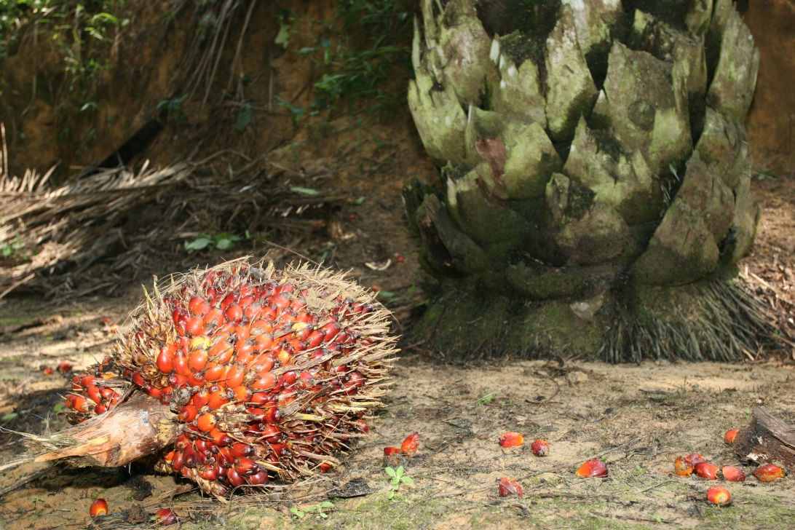
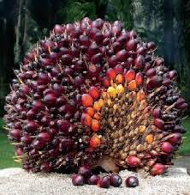
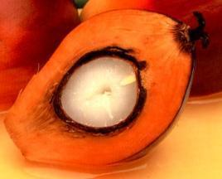
The Fruit bunches contain the individual palm fruits
Notes:
Message:
This slide is at a glance to show how KLK OLEO can be part of our everyday lives, and KLK OLEO product beneficial to our life.
Image:
Examples of consumers product/industrial uses that may contain ingredient produced by KLK OLEO.
Caption:
List of some of KLK OLEO Product Brand Name (but not all) and their functionality in end products. These brands include products produced from Malaysia, China & Europe manufacturing facilities. Refer to note in last slide for detail about the respective brand.
Script:
The first thing in the morning from when we wake up and brush our teeth, take a shower, apply makeup, eat breakfast, did you know that we are actually using ingredients like sweetener, emulsifiers, foam booster, energy source in our personal care products?
From the moment we step out of the house to travel to work and school in our methods of transportation, we are using biodiesel as biofuel. When we reach the office, supplies like printer, computers and fax machines made from plastics, may also contain ingredients made from KLK OLEO products.
At night, the cleansing agent keeps our face clean; when we use body lotion to massage the day’s stress away, the products contain emollient to keep our skin moist.
As you can see, all the products mentioned contain ingredients from KLK OLEO to make us part of your everyday lives.

Slide 14
Fruit flesh (Mesocarp), from which Crude Palm Oil is made, contains a
lot of C16 + C18
The Palm Kernel, from which Palm Kernel Oil is made, contains a lot of C12 + C14
Notes:
Message:
This slide is at a glance to show how KLK OLEO can be part of our everyday lives, and KLK OLEO product beneficial to our life.
Image:
Examples of consumers product/industrial uses that may contain ingredient produced by KLK OLEO.
Caption:
List of some of KLK OLEO Product Brand Name (but not all) and their functionality in end products. These brands include products produced from Malaysia, China & Europe manufacturing facilities. Refer to note in last slide for detail about the respective brand.
Script:
The first thing in the morning from when we wake up and brush our teeth, take a shower, apply makeup, eat breakfast, did you know that we are actually using ingredients like sweetener, emulsifiers, foam booster, energy source in our personal care products?
From the moment we step out of the house to travel to work and school in our methods of transportation, we are using biodiesel as biofuel. When we reach the office, supplies like printer, computers and fax machines made from plastics, may also contain ingredients made from KLK OLEO products.
At night, the cleansing agent keeps our face clean; when we use body lotion to massage the day’s stress away, the products contain emollient to keep our skin moist.
As you can see, all the products mentioned contain ingredients from KLK OLEO to make us part of your everyday lives.

Slide 15
Palm Oil:
- Palmitic Acid -> IPP, EHP - Oleic Acid -> TMPTO, IPO - Stearic Acid -> EHS - Distilled Palm Fatty Acid - Cetearyl Alcohol - Cetyl Alcohol - Stearyl Alcohol - Ethylene Bis Stearamide (EBS)
Notes:
Message:
This slide is at a glance to show how KLK OLEO can be part of our everyday lives, and KLK OLEO product beneficial to our life.
Image:
Examples of consumers product/industrial uses that may contain ingredient produced by KLK OLEO.
Caption:
List of some of KLK OLEO Product Brand Name (but not all) and their functionality in end products. These brands include products produced from Malaysia, China & Europe manufacturing facilities. Refer to note in last slide for detail about the respective brand.
Script:
The first thing in the morning from when we wake up and brush our teeth, take a shower, apply makeup, eat breakfast, did you know that we are actually using ingredients like sweetener, emulsifiers, foam booster, energy source in our personal care products?
From the moment we step out of the house to travel to work and school in our methods of transportation, we are using biodiesel as biofuel. When we reach the office, supplies like printer, computers and fax machines made from plastics, may also contain ingredients made from KLK OLEO products.
At night, the cleansing agent keeps our face clean; when we use body lotion to massage the day’s stress away, the products contain emollient to keep our skin moist.
As you can see, all the products mentioned contain ingredients from KLK OLEO to make us part of your everyday lives.

Slide 16
Palm Kernel Oil:
- Capric Acid - Caprylic Acid - Capric / Caprylic Acid-> MCT
- Lauric Acid -> EHL, IPL
- Myristic Acid -> IPM
- Oleic Acid -> IPO
- Lauryl Alcohol
- Myristyl Alcohol
- “Mid cut” Lauryl/Myristyl Alcohol
- Cetyl Alcohol - Palm Kernel Diethanolamide (Lauramid/CDEA)
Notes:
Message:
This slide is at a glance to show how KLK OLEO can be part of our everyday lives, and KLK OLEO product beneficial to our life.
Image:
Examples of consumers product/industrial uses that may contain ingredient produced by KLK OLEO.
Caption:
List of some of KLK OLEO Product Brand Name (but not all) and their functionality in end products. These brands include products produced from Malaysia, China & Europe manufacturing facilities. Refer to note in last slide for detail about the respective brand.
Script:
The first thing in the morning from when we wake up and brush our teeth, take a shower, apply makeup, eat breakfast, did you know that we are actually using ingredients like sweetener, emulsifiers, foam booster, energy source in our personal care products?
From the moment we step out of the house to travel to work and school in our methods of transportation, we are using biodiesel as biofuel. When we reach the office, supplies like printer, computers and fax machines made from plastics, may also contain ingredients made from KLK OLEO products.
At night, the cleansing agent keeps our face clean; when we use body lotion to massage the day’s stress away, the products contain emollient to keep our skin moist.
As you can see, all the products mentioned contain ingredients from KLK OLEO to make us part of your everyday lives.

Slide 17
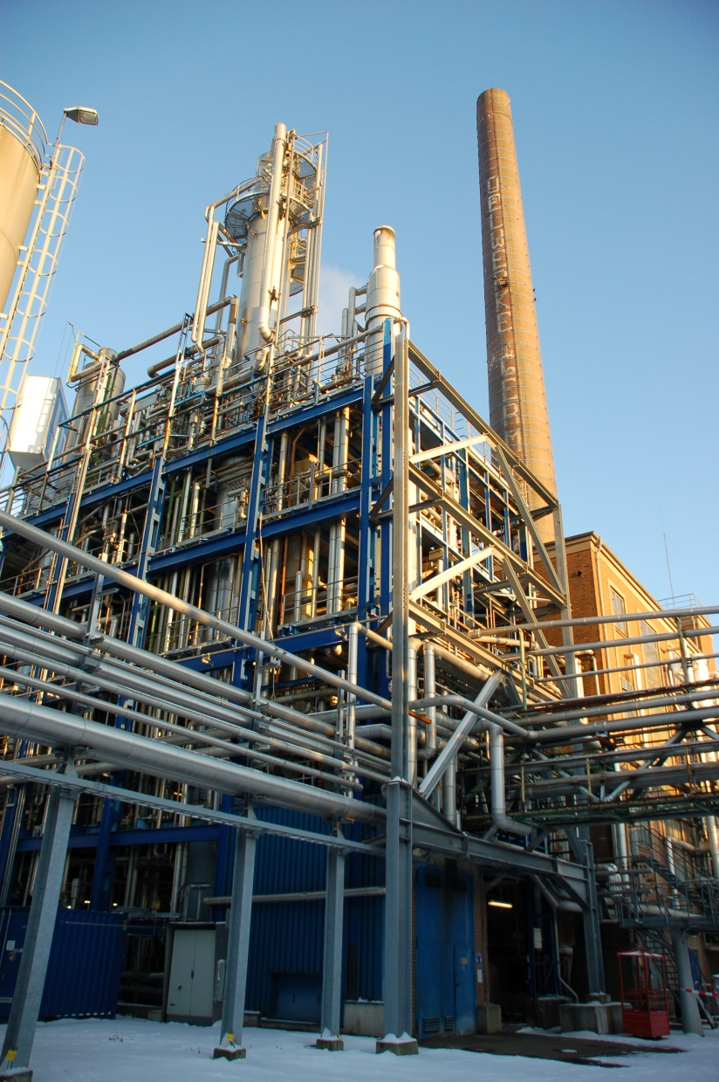
From Oil to Fatty Acid
The oil is transported to our Fatty Acids plants and processed
Notes:
Message:
This slide is at a glance to show how KLK OLEO can be part of our everyday lives, and KLK OLEO product beneficial to our life.
Image:
Examples of consumers product/industrial uses that may contain ingredient produced by KLK OLEO.
Caption:
List of some of KLK OLEO Product Brand Name (but not all) and their functionality in end products. These brands include products produced from Malaysia, China & Europe manufacturing facilities. Refer to note in last slide for detail about the respective brand.
Script:
The first thing in the morning from when we wake up and brush our teeth, take a shower, apply makeup, eat breakfast, did you know that we are actually using ingredients like sweetener, emulsifiers, foam booster, energy source in our personal care products?
From the moment we step out of the house to travel to work and school in our methods of transportation, we are using biodiesel as biofuel. When we reach the office, supplies like printer, computers and fax machines made from plastics, may also contain ingredients made from KLK OLEO products.
At night, the cleansing agent keeps our face clean; when we use body lotion to massage the day’s stress away, the products contain emollient to keep our skin moist.
As you can see, all the products mentioned contain ingredients from KLK OLEO to make us part of your everyday lives.

Slide 18
Simplified Production Flow
Distillation
Splitting
Raw Material (Oils)
Glycerine
Fatty Acids
Distillation
Fractionation
Finished product
Hardening
Finished product

Slide 19
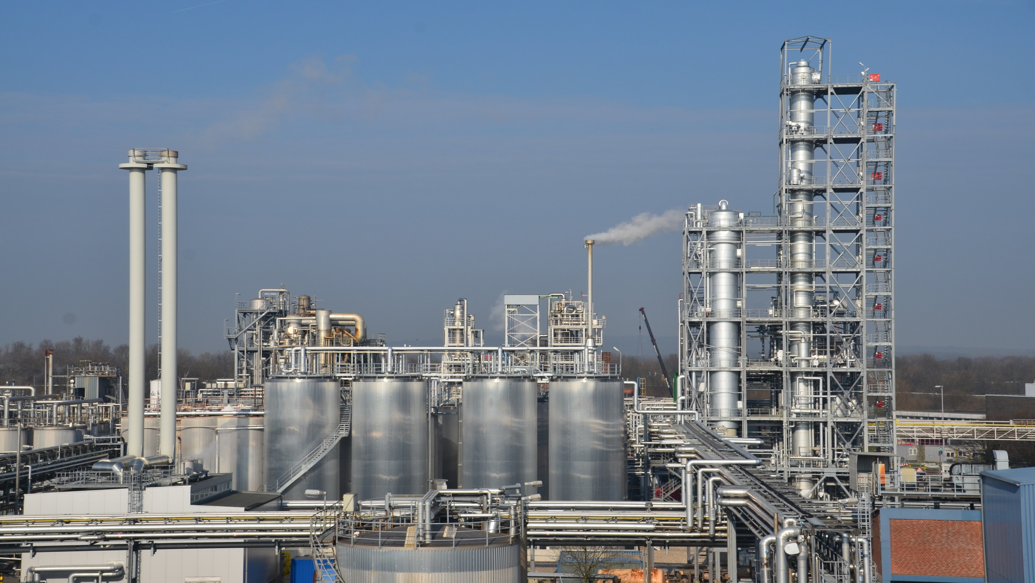
Power plant
Storage
Splitting
Distillation

Slide 20
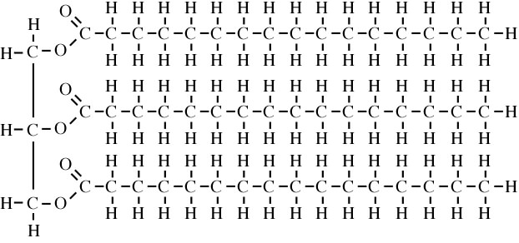
Simplified Production Flow
Distillation
Splitting
Raw Material (Oils)
Glycerine
Fatty Acids
Distillation
Fractionation
Finished product
Hardening
Finished product
Glycerine
Fatty Acids

Slide 21
Simplified Production Flow
Distillation
Splitting
Raw Material (Oils)
Glycerine
Fatty Acids
Glycerine is distilled to 99,5% purity
Distillation
Fractionation
Finished product
Hardening
Finished product

Slide 22
Simplified Production Flow
Distillation
Splitting
Raw Material (Oils)
Glycerine
Fatty Acids
Distillation
Fractionation
Finished product
Hardening
Finished product

Slide 23
Simplified Examples
„Light ends“
„Light ends“
C8
C10
Split
Material
Distilled Fatty Acid:
C8-18, C12-18
C12
DISTILLATION
FRACTIONATION
C14
C16/C18
Residue
Residue

Slide 24
Simplified Production Flow
Distillation
Splitting
Raw Material (Oils)
Glycerine
Fatty Acids
Through Hydrogenation the double bonds are ‚broken‘ and two hydrogen Atoms attached to the fatty Acid
Distillation
Fractionation
Finished product
Hardening
Finished product

Slide 25
This results in the following products:
Fatty Acids
Glycerine
Palmera
Fatty Acids
Palmera
Glycerine
Edenor
Fatty Acids
Edenor
Glycerine
Vegetable Fatty Acids:
C8-C22:1 fractions
Distilled CNFA/PKFA
Stearic Acid
Oleic Acid
Tallow fatty Acids:
Stearic Acid
Oleic Acid
Distilled Tallow Fatty Acid
Tallow Glycerine
Vegetable Glycerine
Pharmaceutical Glycerine
Food Grade Glycerine

Slide 26
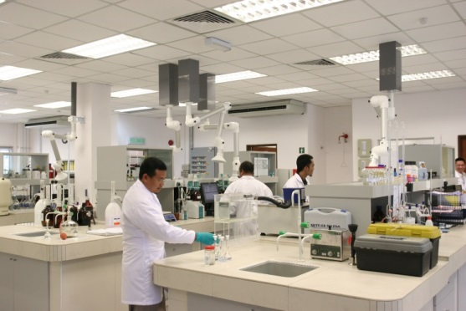
The Fatty Acids and Glycerine produced in this way can be used for further processing:
Neutralisation
Amidation
Esterification
Palmosalt
Soap Noodles
Palmocol PDA
Palm Kernel Di Ethanol Amide
Palmester
Fatty Esters
Palmocol PMA
Palm Kernel Mono Ethanol Amide
90/10
80/20
70/30
EDTA Free
Min 80% CDEA/CMEA
Min 90% CDEA/CMEA
IPM, IPP
EHC, EHP, EHS
MCT
Triacetine
Isostearic Esters (IPIS, PTIS)
Sorbitan Esters (20, 40, 60, 80)
Polysorbates (20, 40, 60, 80)

Slide 27
From the oil also Fatty alcohols can be produced:
Palmerol
Fatty Alcohols
C12-C14
C12-C16
C16
C16-C18 (30/70-50/50)
C18

Slide 28
Sustainability
KLK is committed to supply sustainable products, and is member of RSPO…
…RSPO stands for Roundtable on Sustainable Palm Oil
It is an initiative on sustainable Palm oil products
Members include
- Plantation companies
- Producers of Oil Palm products
- NGO’s (such as WWF)
- Companies in the supply chain of the manufacture of Palm oil products
RSPO offers a certification scheme that enables a manufacturer to use independently verifiable certified sustainable palm oil or palm oil derivatives as a raw material with several levels of ‘commitment’
Identity Preserved
Segregation
Mass Balance
Notes:
Message:
This slide is at a glance to show how KLK OLEO can be part of our everyday lives, and KLK OLEO product beneficial to our life.
Image:
Examples of consumers product/industrial uses that may contain ingredient produced by KLK OLEO.
Caption:
List of some of KLK OLEO Product Brand Name (but not all) and their functionality in end products. These brands include products produced from Malaysia, China & Europe manufacturing facilities. Refer to note in last slide for detail about the respective brand.
Script:
The first thing in the morning from when we wake up and brush our teeth, take a shower, apply makeup, eat breakfast, did you know that we are actually using ingredients like sweetener, emulsifiers, foam booster, energy source in our personal care products?
From the moment we step out of the house to travel to work and school in our methods of transportation, we are using biodiesel as biofuel. When we reach the office, supplies like printer, computers and fax machines made from plastics, may also contain ingredients made from KLK OLEO products.
At night, the cleansing agent keeps our face clean; when we use body lotion to massage the day’s stress away, the products contain emollient to keep our skin moist.
As you can see, all the products mentioned contain ingredients from KLK OLEO to make us part of your everyday lives.

Slide 29
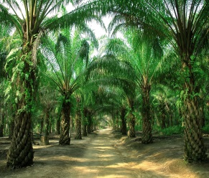
Identity Preserved (IP)
e.g. 100 MT Stearic Acid RSPO IP
A
RSPO Certified Plantation
100 MT Plantation/Mill A
Transport
100 MT RSPO IP Plantation/Mill A
Oleochemical
Processing
100 MT RSPO IP Plantation/Mill A
Notes:
Message:
This slide is at a glance to show how KLK OLEO can be part of our everyday lives, and KLK OLEO product beneficial to our life.
Image:
Examples of consumers product/industrial uses that may contain ingredient produced by KLK OLEO.
Caption:
List of some of KLK OLEO Product Brand Name (but not all) and their functionality in end products. These brands include products produced from Malaysia, China & Europe manufacturing facilities. Refer to note in last slide for detail about the respective brand.
Script:
The first thing in the morning from when we wake up and brush our teeth, take a shower, apply makeup, eat breakfast, did you know that we are actually using ingredients like sweetener, emulsifiers, foam booster, energy source in our personal care products?
From the moment we step out of the house to travel to work and school in our methods of transportation, we are using biodiesel as biofuel. When we reach the office, supplies like printer, computers and fax machines made from plastics, may also contain ingredients made from KLK OLEO products.
At night, the cleansing agent keeps our face clean; when we use body lotion to massage the day’s stress away, the products contain emollient to keep our skin moist.
As you can see, all the products mentioned contain ingredients from KLK OLEO to make us part of your everyday lives.

Slide 30
Segregated
e.g. 100 MT Stearic Acid RSPO SG
A
RSPO Certified Plantation
50 MT Plantation/Mill A
Transport
B
100 MT RSPO SG
Oleochemical
Processing
50 MT Plantation/Mill B
RSPO Certified Plantation
100 MT RSPO SG
Notes:
Message:
This slide is at a glance to show how KLK OLEO can be part of our everyday lives, and KLK OLEO product beneficial to our life.
Image:
Examples of consumers product/industrial uses that may contain ingredient produced by KLK OLEO.
Caption:
List of some of KLK OLEO Product Brand Name (but not all) and their functionality in end products. These brands include products produced from Malaysia, China & Europe manufacturing facilities. Refer to note in last slide for detail about the respective brand.
Script:
The first thing in the morning from when we wake up and brush our teeth, take a shower, apply makeup, eat breakfast, did you know that we are actually using ingredients like sweetener, emulsifiers, foam booster, energy source in our personal care products?
From the moment we step out of the house to travel to work and school in our methods of transportation, we are using biodiesel as biofuel. When we reach the office, supplies like printer, computers and fax machines made from plastics, may also contain ingredients made from KLK OLEO products.
At night, the cleansing agent keeps our face clean; when we use body lotion to massage the day’s stress away, the products contain emollient to keep our skin moist.
As you can see, all the products mentioned contain ingredients from KLK OLEO to make us part of your everyday lives.

Slide 31
Mass Balance
e.g. 100 MT Stearic Acid RSPO MB
A
RSPO Certified Plantation
100 MT Plantation/Mill A
Transport
B
200 MT 100 MT RSPO Mass Balance
100 MT non certified
Oleochemical
Processing
100 MT Plantation/Mill B
100 MT RSPO MB (+100MT non certified)
NON Certified Plantation
Notes:
Message:
This slide is at a glance to show how KLK OLEO can be part of our everyday lives, and KLK OLEO product beneficial to our life.
Image:
Examples of consumers product/industrial uses that may contain ingredient produced by KLK OLEO.
Caption:
List of some of KLK OLEO Product Brand Name (but not all) and their functionality in end products. These brands include products produced from Malaysia, China & Europe manufacturing facilities. Refer to note in last slide for detail about the respective brand.
Script:
The first thing in the morning from when we wake up and brush our teeth, take a shower, apply makeup, eat breakfast, did you know that we are actually using ingredients like sweetener, emulsifiers, foam booster, energy source in our personal care products?
From the moment we step out of the house to travel to work and school in our methods of transportation, we are using biodiesel as biofuel. When we reach the office, supplies like printer, computers and fax machines made from plastics, may also contain ingredients made from KLK OLEO products.
At night, the cleansing agent keeps our face clean; when we use body lotion to massage the day’s stress away, the products contain emollient to keep our skin moist.
As you can see, all the products mentioned contain ingredients from KLK OLEO to make us part of your everyday lives.

Slide 32
Notes:
Message:
This slide is at a glance to show how KLK OLEO can be part of our everyday lives, and KLK OLEO product beneficial to our life.
Image:
Examples of consumers product/industrial uses that may contain ingredient produced by KLK OLEO.
Caption:
List of some of KLK OLEO Product Brand Name (but not all) and their functionality in end products. These brands include products produced from Malaysia, China & Europe manufacturing facilities. Refer to note in last slide for detail about the respective brand.
Script:
The first thing in the morning from when we wake up and brush our teeth, take a shower, apply makeup, eat breakfast, did you know that we are actually using ingredients like sweetener, emulsifiers, foam booster, energy source in our personal care products?
From the moment we step out of the house to travel to work and school in our methods of transportation, we are using biodiesel as biofuel. When we reach the office, supplies like printer, computers and fax machines made from plastics, may also contain ingredients made from KLK OLEO products.
At night, the cleansing agent keeps our face clean; when we use body lotion to massage the day’s stress away, the products contain emollient to keep our skin moist.
As you can see, all the products mentioned contain ingredients from KLK OLEO to make us part of your everyday lives.

