Slide 1
Düllberg Konzentra
THE SUBTLE DIFFERENCE IN PERFUMERY

Slide 6
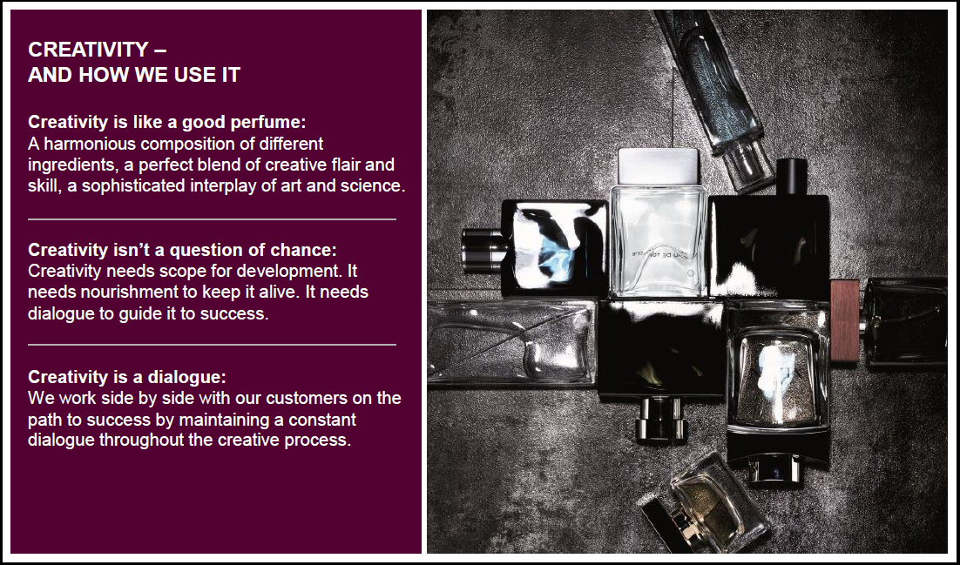

Slide 14
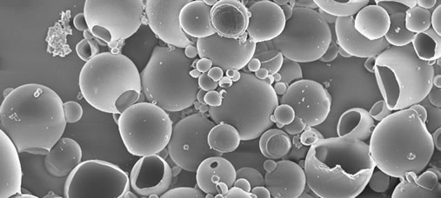
MICROCAPS

Slide 15
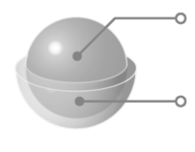
Inside
Fragrance Oil
Outside
Polymer Coating
MICROCAP CONSTRUCTION

Slide 16
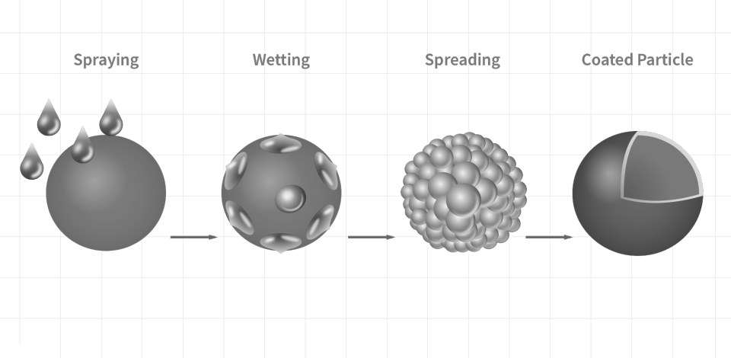
ENCAPSULATION PROCESS

Slide 17
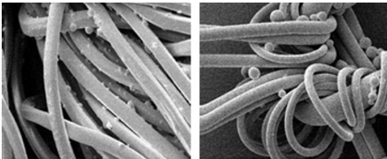
EMBEDDED MICROCAPS

Slide 18

Microcap
Fragrance Oil
RELEASE OF FRAGRANCE OIL

Slide 19
MICROCAPS
BENEFITS:
CONTROLLED RELEASE
IMPROVED LONG-LASTINGNESS
IMPROVED STABILITY
HEAT RESISTANT
IMPROVED SCENT EXPERIENCE

Slide 20
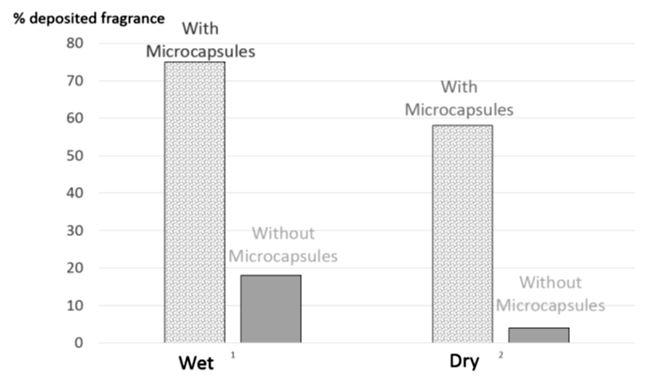
Encapsulation allows to fix fragrance 10x to 20x times more on textile fibers!
Quantity of deposited encapsualted fragrance on wet and dry fabrics vs. Non-ecapsulated fragrance (Liquid Fabric Softener)

Slide 21
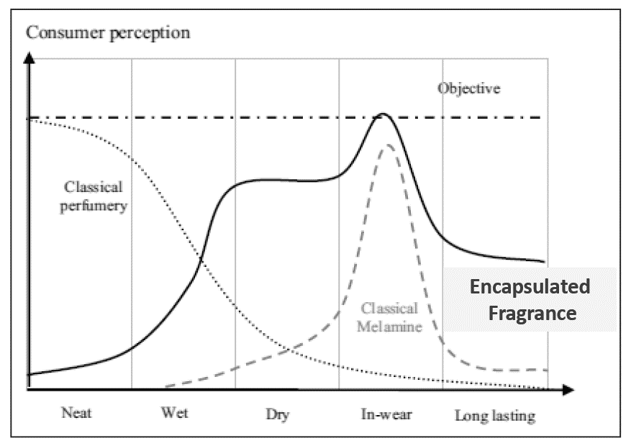
Long-Lasting Fragrance Performance
Fragrance release profile on cotton towel washed with an encapusalted fragrance vs. non-encapsulated fragrance.

Slide 22
MICROCAPS
APPLICATIONS:
FABRIC [Softeners & Detergents]
AIR CARE [Pump Spray]
SURFACE [Floor · Glass · All Purpose Cleaners]
PERSONAL [Shampoo · Shower Gel · Deo]

Slide 23
MICROCAPS
PUMP SPRAY APPLICATION:
Water-Based dispersions include about 85% to 99% water, 0.1% to 5% fragrance oil, 0.1% to 0,3% xanthan gum, and 0.1% to 2% by weight preservative.

Slide 25
Thank you!

