Slide 1
Notes:
Company Introduction
Why customers buy new product
How trends, emotional factors & fragrances influence consumers‘ needs, desires & satisfaction.

Slide 2
Notes:
Consumers are more demanding than ever & expect more choice than ever before.
6 in 10 people say they like when brands offer new products
+50% of shoppers purchased a new product – last shopping trip
SO HOW DO YOU GAIN AN UNDERSTANDING OF WHAT DRIVES CONSUMERS‘ NEEDS & DESIRES?

Slide 3
Notes:
Global megatrends reveal important insights into consumers‘ desires to buy more new products.
Global megatrends allow us to anticpate change with confidence.
We don‘t have to predict global megatrends:
They are not fads
They are already present
They mark changes that have already shaped us
They are constants of our global society
They are deep currents of change – That span for several decades
Global megatrends are a roadmap to what consumers say they are buying now + more importantly what they wish they could buy if it were available.

Slide 6
Цена против производительности
Notes:
It’s tempting to cost cut the cost of raw materials.
But, is important to understand what trade-offs and sacrifices in quality consumers will accept.
My methods!

Slide 7
ЦЕНА ДЕНЕГ

Slide 8
PURCHASE DECISION:

Slide 9
LOYALTY IMPACT:

Slide 10
People Don’t Buy Products, They Buy Better Versions of Themselves

Slide 11
CONSUMER ENGAGEMENT
PRECIEVED VALUE & PRICE
INWARDLY FOCUSED VALUE
OUTWARDLY FOCUSED VALUE
The True Elements of Value

Slide 12
HEALTHY
LIFE
BIOPHILIA

Slide 13
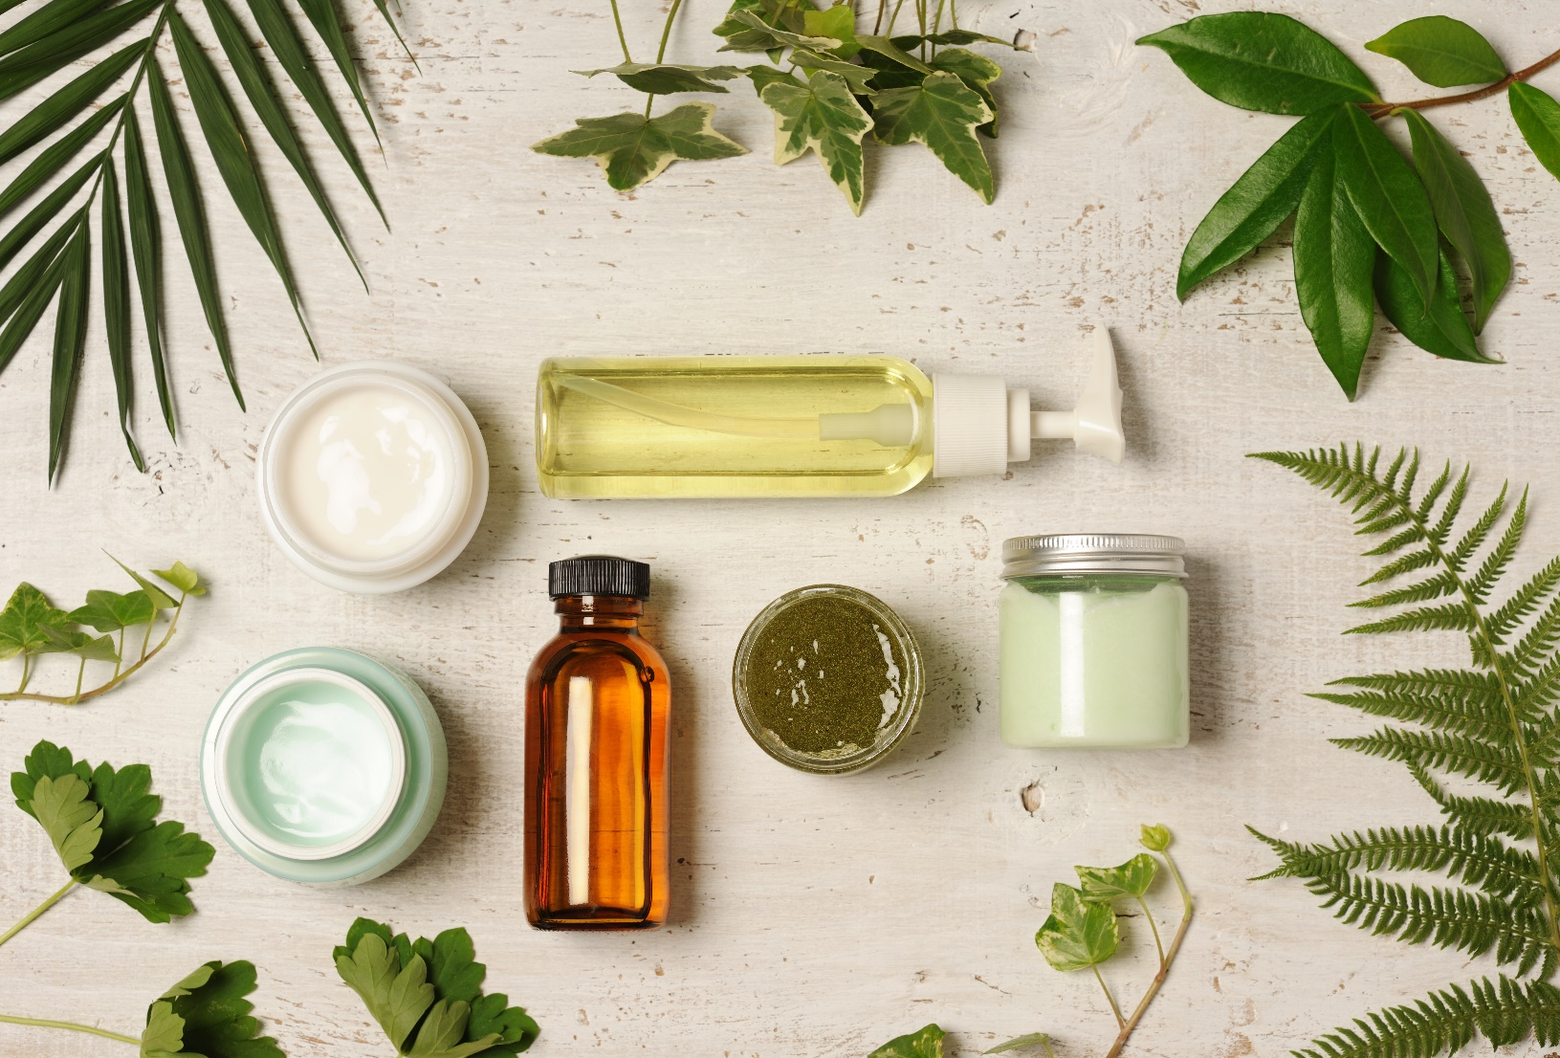
What do consumers‘ expect in nature inspired products
49%
Ingredients
they understand
55%
Types of Ingredients used
49%
Free from certain ingredients

Slide 14
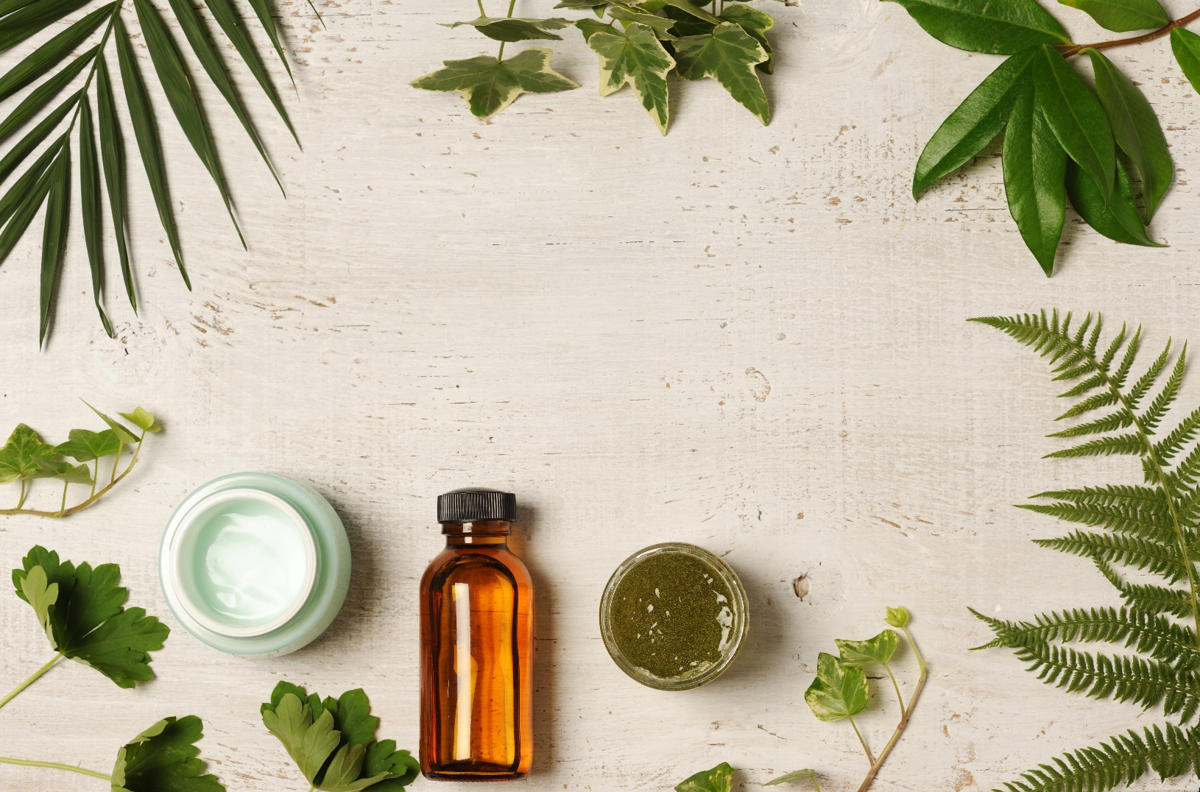
2014729
Sencha Tea Leaves
Refreshingly light. Calming the body, senses and spirit. Sparkling green leafy herbal floral fragrance. Green tea leaves, freesia, jasmine petals, apricot, marine notes, white musk.
49%
Free from certain ingredients

Slide 15
2014798
Green Tea & Kale
Natura
Invigorating. Sparkling. Natural ingredients combined to create a balanced fragrance experience. Grapefruit, bergamot, bitter orange, green tea, rosmary, rose, maté, incense.

Slide 16
2014802
Safe Melon & Cucumber
Nature’s Garden. Fresh. Fun. Cool. Watery. Fantastic mix of summer honeydew and sweet watermelon combined with crisp, cucumber.
49%
Free from certain ingredients

Slide 17
CONCLUSION:
Mega Trends Drive Consumer Values & Desires
Quality & Fragrance are the Most Valuable Elements of a Product
People Don’t Buy Products They Buy Better Versions of Themselves

