Slide 1

the natural way of alternative preservation
InterCHARM 2018

Slide 2
Agenda
Cosphatec GmbH: Who we are
Cosmetic trends Europe
Challenge of preservation
Cosphaderm Multifunctionals

Slide 3
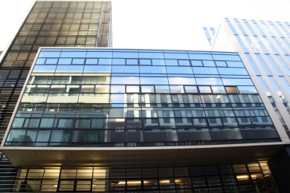

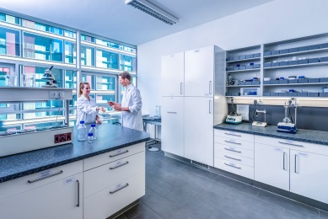
Cosphatec GmbH
Founded: 2005
Office, lab and warehouse in Hamburg, Germany
Subsidiary: Shanghai, China
Production site: Hannover, Germany

Slide 4
Cosphatec GmbH
Core Business
Development, production and trade of raw materials
Focus: Natural alternative preservatives
Trademark: Cosphaderm® and Cosphagard®
Notes:
Absatz nach 6 pt

Slide 5
Cosphatec GmbH
Expertise
Technical support
Regulatory support
Free challenge testing
Frame formulations
Individual preservation strategies
Notes:
Innovative research etc: competitive advantages for us and for our customers

Slide 6

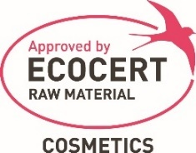
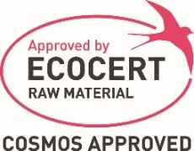

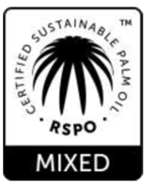




Certifications
Natural cosmetics labels
RSPO Mass Balance
Organic, Vegan, Kosher, Halal
DE-ÖKO-005
9-1769-16-100-00

Slide 7
Cosphatec GmbH
Product groups
Alternative preservatives: Multifunctionals
Natural Antioxidants
Natural Emulsifiers
Natural Thickening Agents
Natural Actives
Notes:
Innovative research etc: competitive advantages for us and for our customers

Slide 8
Agenda
Cosphatec GmbH: Who we are
Cosmetic trends Europe
Challenge of preservation
Cosphaderm Multifunctionals

Slide 9
Cosmetics: Trends Europe
Certifications
Preservative
free
Transparency
Silicone
free
Anti-polution
Trust
and
customer beliefs

Slide 10

Cosmetics: Transparency
Increasing consumer’s sensibility
Increasing regulations by EU, FDA or others
Increasing number of rating websites and apps
Example: EWG.org

Slide 11


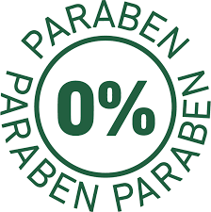


Cosmetics: „Free“ claims

Slide 12
Conclusion
Consumers can easily check ingredients
Reports have an influence on the market
Acceptance of raw materials is changing
Replacement of harmful ingredients will be the future
Cosphatec GmbH is specialized in alternative preservatives to replace harmful ingredients

Slide 13
Agenda
Cosphatec GmbH: Who we are
Cosmetic trends Europe
Challenge of preservation
Cosphaderm Multifunctionals

Slide 14
The right way of preservation
Preservation is more than eliminating bacteria, yeasts and molds.
It is rather the art to make cosmetics unattractive for germs –
but very attractive for consumers!

Slide 15
Challenge of preservation
Hydrophobic antimicrobial
Hydrophilic antimicrobial
Cannot pass
Can pass
Outer membrane
Cell wall
Murein
Murein
Cytoplasm membrane
Cytoplasm membrane
Cytoplasm
Cytoplasm membrane
Cytoplasm
Cytoplasm
Gram negative Bacteria
Gram positive Bacteria
Yeasts and molds

Slide 16
Challenge of preservation
O/W emulsion
W/O emulsion
Water phase: growth of germs
Oil phase: location of oil soluble substances
Oil phase: location of oil soluble substances
Water phase: growth of germs

Slide 17
Challenge of preservation
Surfactant-based formulation
Water-based formulation
Oil soluble substances encapsulated in detergent micelles
Precipitation of oil soluble antimicrobial substances

Slide 18
Agenda
Cosphatec GmbH: Who we are
Cosmetic trends Europe
Challenge of preservation
Cosphaderm Multifunctionals

Slide 19
Categories of preservatives
Listed preservatives
Alternative preservatives: Multifunctionals
harsh
chemicals
synthetic products
nature-identical
products
natural products
softer chemicals
· Parabens
· MIT
· Trioclosan
· Formaldehyde
seperators
· Glycols
· Diols
· Organic acids
· Diols
· Organic acids
· Diols
· Extracts
· Organic esters
· Phenoxyethanol
· Benzyl alcohol
· Benzoic acid

Slide 20
Cosphaderm® Multifunctionals
High antimicrobial activity
Less negative side effects
Several properties to boost formulations
Non GMO, no allergenic potential
Used to replace harsh chemicals
Not listed in the EU Cosmetics Regulation
Certified natural versions

Slide 21
Cosphaderm® Organic acids
Most commonly used
Very efficient: Low cost alternative
Recommended pH value: 5.0
at pk_{A} 50:50
Acid
Salt
Strong antimicrobial efficiency
Low water solubility
No antimicrobial efficiency
High water solubility

Slide 22




Cosphaderm® Organic acids
Cosphaderm® | INCI | Efficient against | pkA | Acid content pH 5.0 | Acid content pH 5.5
LA-T | Levulinic Acid | Bacteria | 4.5 | 23 % | 8.5 %
AS | p-Anisic Acid | Yeast, Moulds | 4.5 | 23 % | 8.5 %
pAS natural | p-Anisic Acid | Yeast, Moulds | 4.5 | 23 % | 8.5 %
Mainly used in:

Slide 23
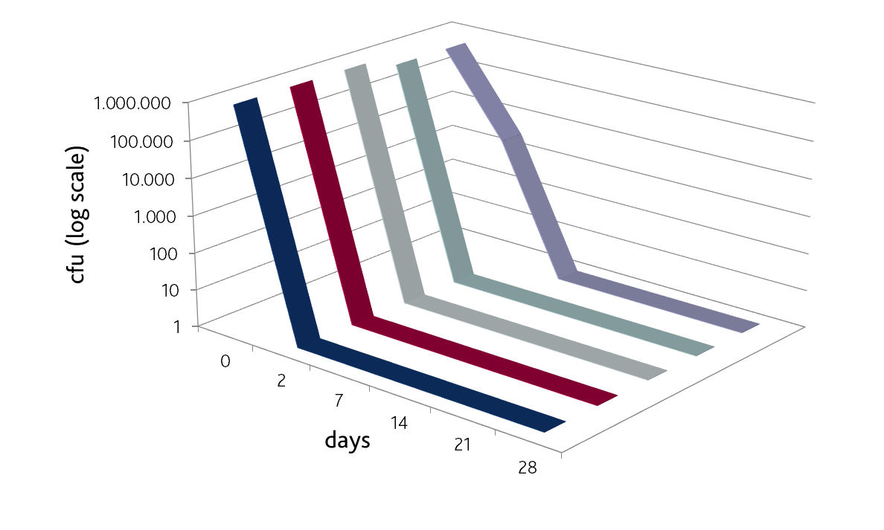
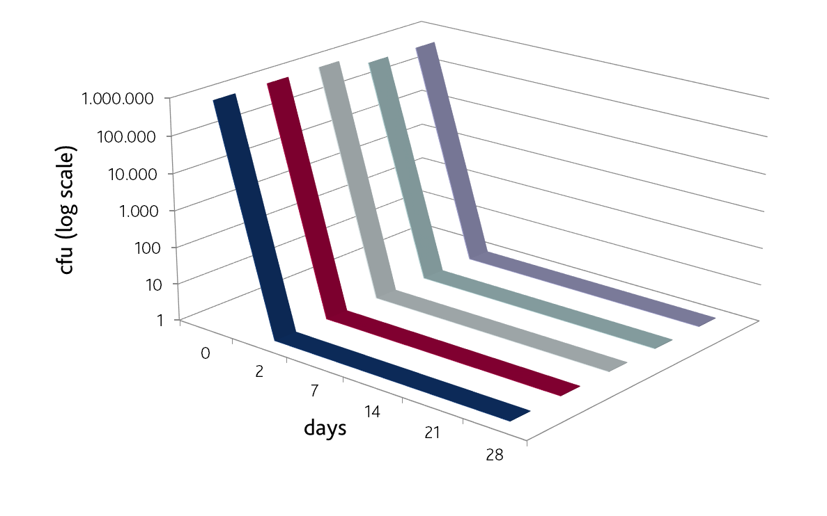
Cosphaderm® Organic acids
Challenge test results:
Levulinic Acid + p-Anisic Acid
0.8 % Cosphaderm® LA-T
+ 0.2 % Cosphaderm® pAS natural/ AS
baby cream at pH 5.5
1.2 % Cosphaderm® LA-T
+ 0.2 % Cosphaderm® pAS natural/AS
Shampoo at pH 5.5

Slide 24
Cosphaderm® Diols
pH independent efficient
Soluble in water and oil
Moisturizing effect
Reduce the particle size of emulsions
Penetration enhancer
Increase the water resistance of sun filters
Mainly used in:

Slide 25
Cosphaderm® Diols
Cosphaderm® | INCI | Antimicrobial efficiency | Source | Water solubility
Propanediol natural | Propanediol | Booster | Natural | Clear
Pentiol natural | Pentylene Glycol | Good | Natural | Clear
Pentiol GL | Pentylene Glycol | Good | Synthetic | Clear
Hexiol | 1,2-Hexanediol | Very good | Synthetic | Clear
Octiol | Caprylyl Glycol | Excellent | Synthetic | Limited

Slide 26
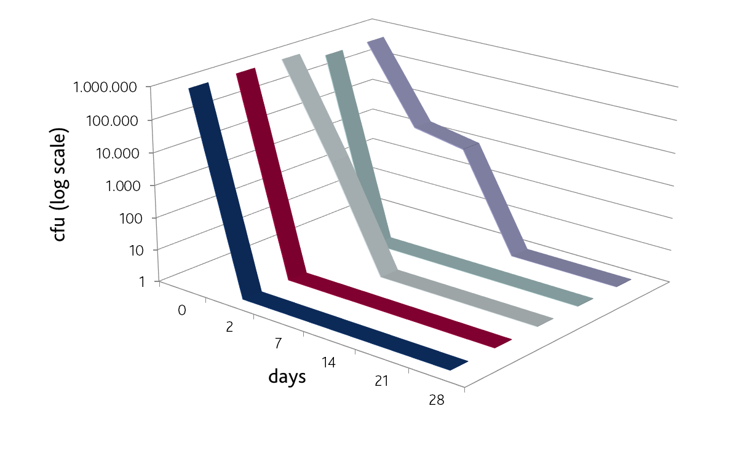

Cosphaderm® Diols
Challenge test results of Cosphaderm® Diols
0.6 % Cosphaderm® Hexiol
+ 0.4 % Cosphaderm® Octiol
daycream at pH 5.5
0.5 % Cosphaderm® Octiol
+ 1 % Cosphaderm ® Pentiol GL
conditioner at pH 4.0

Slide 27
Cosphaderm® Magnolia Extract 98
Strong efficiency against yeasts and molds
Anti-inflammatory
Anti-acne
Anticariogen
Antioxidative efficiency
Soluble in oil, alcohol, diols and esters
pH independent efficient
INCI: Magnolia Officinalis Bark Extract
Mainly used in

Slide 28
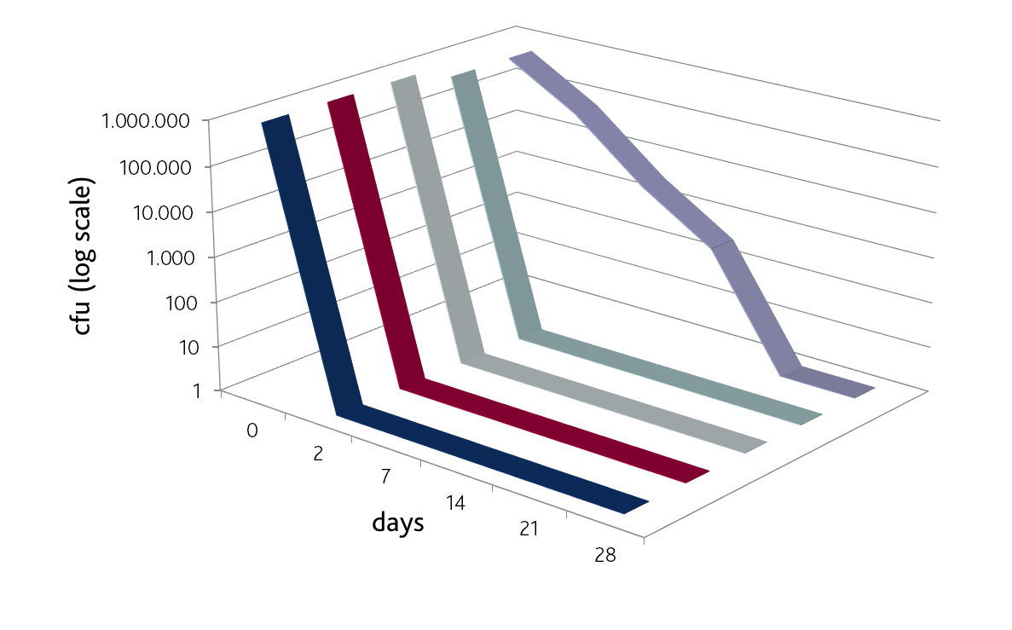
Cosphaderm® Magnolia Extract 98
Challenge test results
0.1 % Cosphaderm® Magnolia Extract 98
+ 0.5 % Cosphaderm® GMCY
O/W emulsion at pH 4.5

Slide 29
Cosphaderm® Magnolia Extract 98
Anti-acne effect
0.0045 % Magnolol kills acnes bacteria within 10 minutes
0.0020 % Honokiol kills acnes bacteria within 10 minutes
MIC against Propionibacterium acnes = 0.0003-0.0009 %
MIC against Propionibacterium granulosum = 0.0077 %
Park J., Lee J., Jung E., Park Y., Kim K., Park B., Jung K., Park E., Kim J. and Park D. (2004): In vitro antibacterial and anti-inflammatory effects of honikiol and magnolol against Propionicaterium sp. Eur J Pharmacol 496:189-195.

Slide 30
Cosphaderm® Magnolia Extract 98
Anti-cariogenic and anti-paradontitis properties for oral care
MIC against Streptococcus mutans = 0.0098 %
MIC against Streptococcus oralis = 0.0098 %
MIC against Actinobacillus = 0.025 %
MIC against Fusobacterium nucleatum = 0.031 %
MIC against Porphyromonas gingivalis = 0.008 %

Slide 31
Cosphaderm® Blends
Mixtures of several products
Increased efficiency caused by synergetic effects
Efficient against bacteria, yeasts and moulds
Very user friendly to handle

Slide 32
Cosphaderm® Natural Blends
Cosphaderm® | Ingredients | Water soluble | pH limitation
MultiMEG | Glyceryl Caprylate, Pentylene Glycol, Magnolia Officinalis Bark Extract | No | pH 3.0 – 7.0
TOM | Pentylene Glycol, Glyceryl Caprylate, Glyceryl Undecylenate | No but dispersible | pH 3.0 – 7.0
GeMix | Glyceryl Caprylate, Glyceryl Undecylenate | No but dispersible | pH 3.0 – 7.0

Slide 33


Cosphaderm® Natural Blends
Challenge test results
1.5 % Cosphaderm® MultiMEG
body lotion at pH 7.0
2.0 % Cosphaderm® TOM
hydrogel at pH 5.5

Slide 34
Cosphaderm® Synthetic Blends
Cosphaderm® | Ingredients | Water soluble | pH limitation
POP | Propanediol, Caprylyl Glycol, Phenylpropanol | Yes | pH 3.0-7.0
Dicapo | Caprylyl Glycol, Glyceryl Caprylate, Dipropylene Glycol | No but dispersible | pH 3.0-7.0

Slide 35
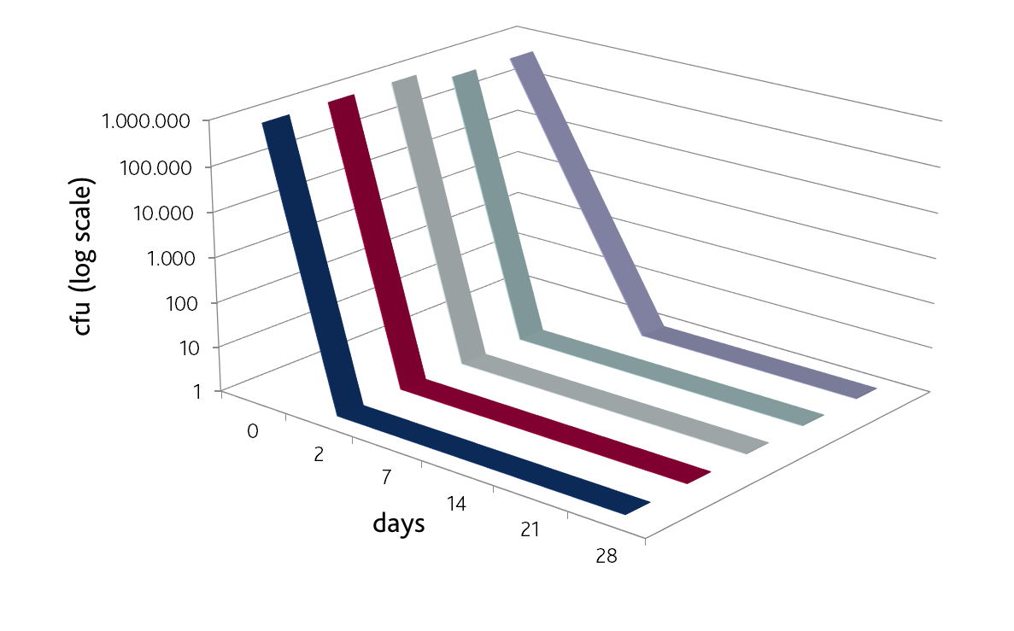
Cosphaderm® Synthetic Blends
Challenge test results
0.7 % Cosphaderm® Dicapo
O/W emulsion at pH 6.0

Slide 36
Cosphaderm® Preservative Blends
Mixtures of listed and non-listed preservatives
Start with alternative preservatives
Lower the percentage of listed preservatives
Efficient against bacteria, yeasts and moulds

Slide 37
Cosphaderm® Preservative Blends
Cosphagard® | Ingredients | Water soluble | pH limitation
Pretec | Phenoxyethanol, Benzyl Alcohol, Phenylpropanol | No but dispersible | Without limitation
Presol | Phenoxyethanol, Benzyl Alcohol, Phenethyl Alcohol | Yes | Without limitation
Precare | Aqua, Sodium Levulinate, Sodium Benzoate | Yes | Max pH 6.0

Slide 38
Let us help you
Information required to choose the right strategy:
Type of formulation
Final pH-value
Certification as natural cosmetics
Preference: single ingredients or blends
Raw material replacement
INCI List

Slide 39

Thank you!

