Slide 1
sulfate-free surfactants meeting trends, technologies and formulating expertise
Susan Pye InterCharm Conference, September 2019

Slide 2
product claims: a rise in sulfate-free
shampoo and skin cleansers, Mintel 2019

Slide 3
Innospec sulfate-free portfolio
Primary Surfactants
Selection based on formulation pH,
cost, naturalness
Secondary Surfactants
Selection based on viscosity and foam/
texture /application
Type | Product name
SLMI | Iselux® range
SCI | Pureact I-series
Taurates | Pureact WS range Pureact TR-L90 *NEW*
AOS | Nansa® range
CAPB | Empigen® BS/FA and BS/H50
APG/Lactylate | Pureact 138 *NEW*
Type | Product name
CAPB | Empigen® BS/FA and BS/H50
Alkyl Betaine | Empigen® BB and CBET
Amphoacetates | Empigen® range
Sarcosinate | Pureact LSR
Taurates | Pureact WS, MS range Pureact TR-L90 *NEW*
Glycinates | Pureact SLG, Pureact SCG
APG | Pureact Gluco range
APG/Lactylate | Pureact 138 *NEW*
Thickeners
Selection based on several parameters
Conditioning
Selection based on several parameters
Electrolytes (NaCl, NH₄Cl) | Low cost
PEG esters | Clarity
Cocamide (Empilan® series) | High/low shear viscosity
Polymers | Suspension, clarity
Type | Product name
Cationic Guars | Activsoft range
Cationic Polymers | PQ10, PQ7, PQ37, PG22
Amido amines | Empigen® S18
Silicones & Derivatives | Innospec speciality silicone range
We also have expertise in formulating in combination with non-Innospec surfactants

Slide 4
Popular Sulfate-Free Anionic Surfactants | pH Stability Range
Sodium Lauroyl Methyl Isethionate (Iselux®) | 5.0 – 9.0
Sodium Cocoyl Isethionate (Pureact I-series) | 6.0 – 8.5
Sodium Lauryl Sulfoacetate | 6.0 – 8.5
Sodium Laureth Sulfosuccinate (Empicol® SDD/O) | 6.0– 8.5

Slide 5
Popular Sulfate-Free Anionic Surfactants (Continued) | pH Stability Range
Sodium Methyl Cocoyl Taurate (Pureact WS) | 3.0 - 11.0
Sodium Lauroyl Sarcosinate (Pureact LSR) | 3.0 - 11.0
Sodium C14-C16 Olefin Sulfonate (Nansa® LSS) | 3.0 - 11.0

Slide 6
Optimum pH ranges of Innospec Surfactants
pH range for organic acid preservatives efficacy
Empicol® SDD/O (Disodium Laureth Sulfosuccinate)
Pureact LSR (Sodium Lauroyl Sarcosinate)
pH
4
5
6
7
8
9
Pureact I Grades
(Sodium cocoyl Isethionate)
Iselux®
(Sodium Lauroyl Methyl Isethionate)
Low solubility in acid form
Pureact SCG
(Sodium Cocoyl Glycinate)
Pureact Gluco Grades (Alkyl Glucosides)
Amphoacetates & Betaines
Pureact WS & MS Grades
(Sodium Methyl Alkyl Taurates)
Nansa® LSS Grades
(Sodium C₁₄-C₁₆ Olefin Sulfonate)

Slide 7
Stability Issues Surfactant Hydrolysis in Formulations at Acidic pH
Loss of clarity
In clear systems due to break down into insoluble fatty acids
Can be masked with pearlisers (but gives additional cost and also a need for stabilisation of the pearliser)
Change in viscosity
Due to depletion of surfactant
Normally shows initial increase with low levels of fatty acid then rapid drop in viscosity as surfactant level drops and rate of hydrolysis increases due to auto catalysis. Can be masked with rheology modifiers which don’t rely on surfactants to thicken, e.g. carbomers, xanthan, cellulose gums
Loss in foam performance
Reduction in flash and total foam volume
Depletion of surfactant gives a reduction in flash and total foam volume. Can be masked by deliberately overloading the surfactant levels. But at additional cost!
Instability
With fragrances and oils

Slide 8
Iselux® INCI: Sodium Lauroyl Methyl Isethionate
Features
Benefits
Dense creamy lather
Creates a luxurious bath / shower
High flash foam
experience
Mild surfactant, low irritation
Ideal for sensitive skin
Excellent water solubility
Can be used easily in clear systems
Easy to handle forms
High concentration flake
Cold process liquid
Surfactant concentrates
Ease of manufacturing
Readily biodegradable
Environmentally friendly
Naturally derived
Viscosity build with CAPB
Dramatic formulation flexibility
pH stability 5.0 - 9.0
Formulating flexibility
Organic acid preservative compatibility

Slide 9
Product Launches with Iselux® INCI: Sodium Lauroyl Methyl Isethionate
Data from Mintel 2019

Slide 10
Pureact WS Series INCI: Sodium Methyl Cocoyl Taurate Pureact MS Series INCI: Sodium Methyl Oleoyl Taurate
Features
Benefits
Mixed foam profile,
Large and small bubbles
Creates a luxurious bath / shower
experience
Mild surfactant, low irritation
Ideal for sensitive skin
High Foaming in the presence of
oil and sebum
High oil cleansing formulations
Sebum removal anti acne
Powder (>70% active)
Paste (30% active)
Mobile Liquid (22% active)*
Ease of handling in manufacturing
Readily biodegradable
Environmentally friendly
Derived from natural resources
Wide pH stability 3.0 - 11.0
Extreme pH formulations possible
Feminine hygiene, anti acne treatments, fatty acid soaps
* Unique to Innospec Pureact WS-70

Slide 11
Product Launches with Sodium Methyl Cocoyl Taurate
Data from Mintel 2019

Slide 12
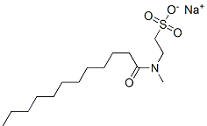
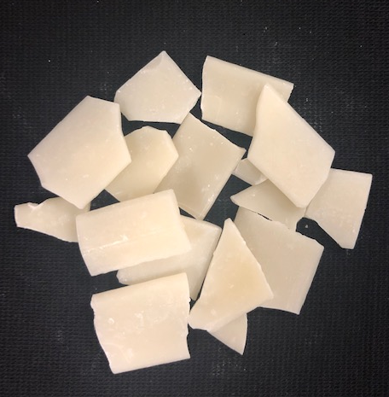
New product launch
Pureact TR-L90
INCI: Sodium Methyl Lauroyl Taurate
High foaming sodium chloride-free, mild, anionic, solid flake surfactant.
Suitable as a primary or secondary surfactant.
No NaCl - more suitable for applications such as toothpastes and other oral care products.
Starting formulations available.

Slide 13
Nansa® LSS Series INCI: Sodium C14-C16 Olefin Sulfonate
Features
Benefits
Mixed profile large/small bubbles
Creates a luxurious bath / shower
experience
High foaming with oils
High oil cleansing formulations
Sebum removal anti acne
Powder (80% active)
Mobile liquid (28% active)
Ease of handling in manufacturing
Readily biodegradable
Environmentally friendly
Readily builds viscosity
with amphoteric surfactants
Formulating flexibility
Wide pH stability: 3.0 - 11.0
Extreme pH formulations possible
Cost effective

Slide 14
Product Launches with Sodium C14-16 Olefin Sulfonate
Data from Mintel 2019

Slide 15
Pureact 138 INCI: Decyl Glucoside (and) Sodium Lauroyl Lactylate
New product launch
Mild and rich creamy foaming.
Suitable as a primary or secondary surfactant blend.
Cold processable.
Usage level - 2 – 30%
Preservative free.
Both components are derived from natural, readily renewable resources. (100% naturally derived)
Recommended for hand soap, body wash, shampoos, facial cleansers and “natural” products.
Starting formulations available.

Slide 16
formulating sulfate-free considerations
Specific application
Sulfate-free surfactants can produce a wide variety of foam textures They have different levels of compatibility with cationics used as conditioning agents Some are thus more suitable for use in skin/facial cleansers and others have better performance in hair care applications
Target pH
SLS and SLES have broad pH stability range Suitable pH ranges can be narrower for some sulfate-free surfactant technology, based on their chemistry (e.g esters or amides) Low pH systems (< pH 5) are frequently required for organic acid preservation
Level of natural ingredient claim
Possibility to use synthetic/petrochemical products based on claim, required mildness, and cost, performance targets Percentage naturally derived requirements following ISO16128-1&2 or other standards/ natural % calculations Cosmos/Ecocert approved material requirements
Target viscosity
Viscosity build from surfactants and electrolytes alone? Other claim requirements for the thickening system (Natural, EO free, Acrylate free)? Particle suspension or emulsion stabilisation required?

Slide 17
formulating sulfate-free considerations (continued)
Transparency
Crystal clear or translucent formulation Opaque or pearlised, suspension stabilisation of particles yield
Texture
Texture : cream, butter, lotion, gel Packaging type: bottle, tube, pot
Other considerations
Cold process manufacturing Formulation cost Formulation globally compliant Mildness
Additives
Incorporation of fragrance, oils, actives, silicones e.g. PEG-X hydrogenated Castor Oils and Polysorbate 20 significantly depress viscosity build with sulfate free will need rheology modifiers Polyglyceryl-X based emulsifiers have much lower negative impact on viscosity e.g. Tego Solv 61

Slide 18
10% w/w Active Iselux® + Cocamidopropyl Betaine (pH 6.0) Viscosity Brookfield RVT, 20rpm # 2, 3, 4 and 5
Electrolyte Thickening of Iselux®/CAPB Systems
A binary system using Iselux® + betaine increased formulation viscosity
Topped fatty acid betaines provide increased viscosities at lower concentrations vs. oil based betaines
6% Active Betaine (oil based)
Viscosity / cps 20°C
4% Active Betaine (Empigen® BS/FA) (stripped fatty acid based)
4% Active Betaine (oil derived)
2% Active Betaine (Empigen® BS/FA)
2% Active Betaine (oil derived)
0% Betaine
NaCl / % w/w
Choice of CAPB grade is important: Stripped/topped fatty acid based CAPBs give the highest viscosity compared to triglyceride oil based CAPBs

Slide 19
Electrolyte Thickening of Pureact WS Conc/CAPB Systems
Binary system using Pureact WS Conc + CAPB increases formulation viscosity
Topped fatty acid CAPB provides higher viscosities at lower concentrations of sodium chloride compared to ‘oil derived’ CAPB
Empigen® BS/FA
(Fatty Acid Based (Topped) (~30% Active)
(Oil derived )
(~30% Active)
Competitor B
(Hardened Oil derived CAPB)
(~38% Active)
Choice of CAPB grade is important: Stripped/topped fatty acid based CAPBs give the highest viscosity compared to triglyceride oil based CAPBs
6% Active Sodium Methyl Cocoyl Taurate, 4% Active Cocamidopropyl Betaine, pH 5.0
Viscosity Brookfield RVT, 20 rpm # 2, 3 and 4

Slide 20
10% Active Iselux® and Cocamidopropyl Hydroxysultaine
pH 5.8

Slide 21
Electrolyte Thickening of Nansa® LSS 38/AV
with amphoteric surfactants
Lauryl Betaine
Sodium lauroamphoacetate
Sodium cocoamphoacetate
Disodium Cocoamphodiacetate
9%w/w Active Sodium C14-C16 Olefin Sulfonate, 3%w/w Active amphoteric, pH 5.0

Slide 22
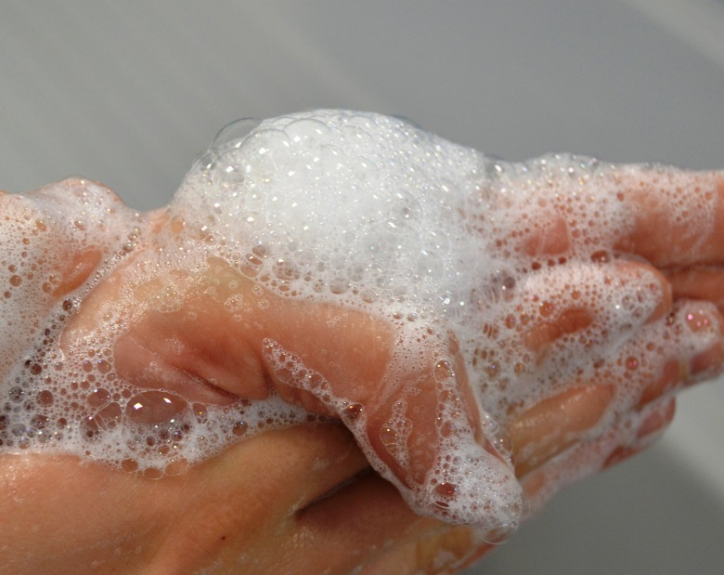
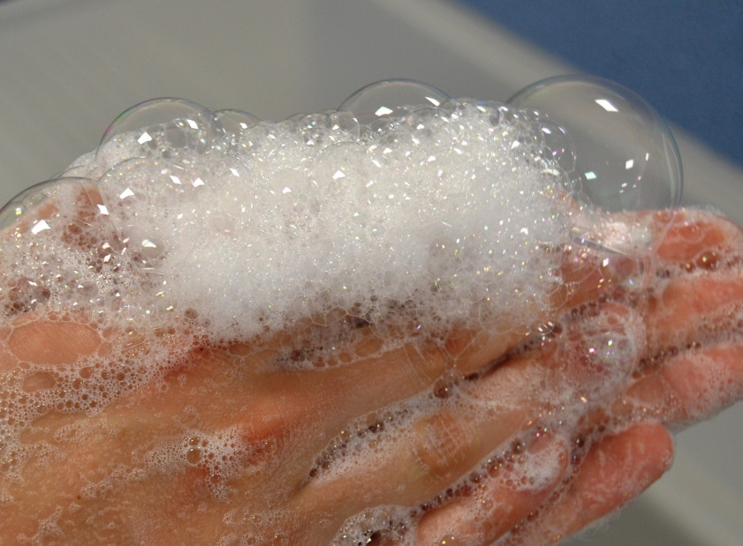
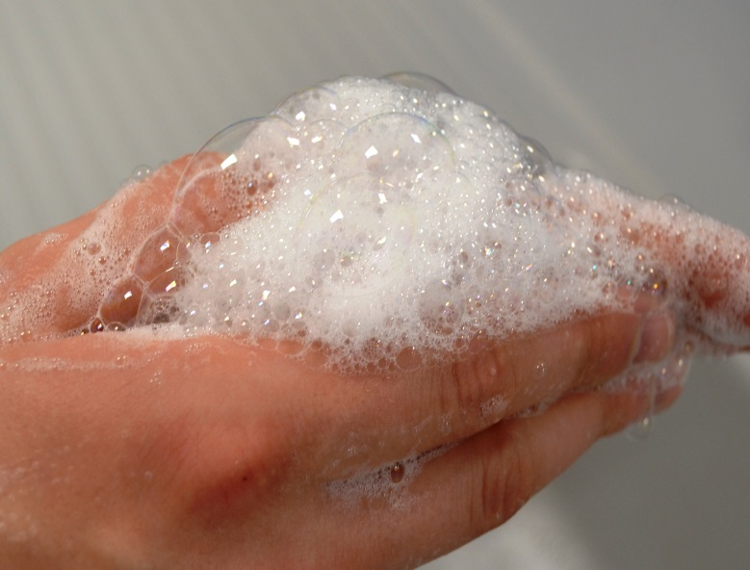
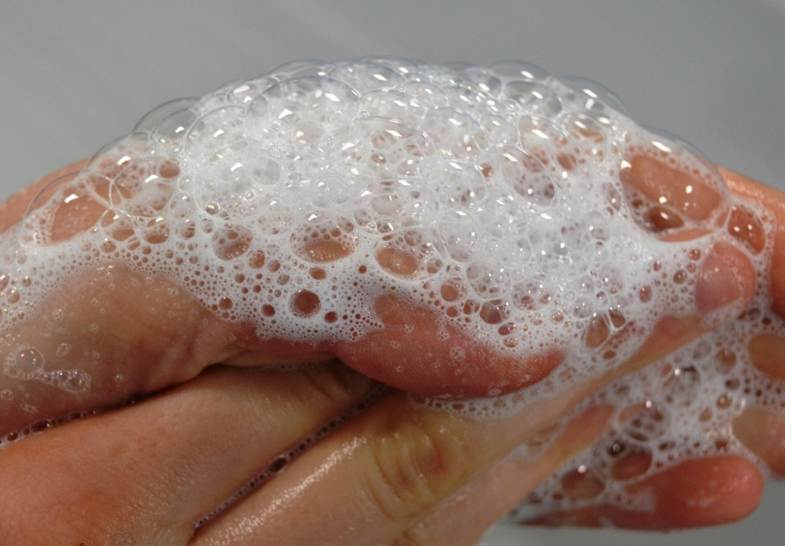
Foam textures with Pureact WS Conc Effect of co-surfactants
Pureact WS Conc & CAPB
Pureact WS Conc & CAPB & Pureact LSR
Pureact WS Conc & CAPB & Iselux®
Pureact WS Conc & CAPB & Gluco L

Slide 23
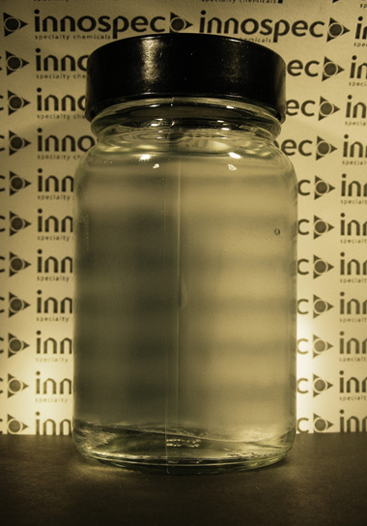
Conditioning Agents with Pureact WS Low pH
5% SMCT, 4.5% CAPB, 0.2% PQ-10
NaCl q.s. to 5,000cps
Adding high levels of salt can cause the separation of cationic polymers (complex coacervate)
Worse effect at low pH
Adding co-surfactants helps – lower salt levels needed to thicken
Coacervate formed of PQ 10 and anionic surfactant, ‘salted’ out of formulation (45°C)

Slide 24
Effect of surfactants on stability and clarity Cationic polymers at low pH
INCI | Trade Name | % w/w
 |  | A | B | C | D | E | F
Aqua |  | q.s. to 100 | q.s. to 100.0 | q.s. to 100 | q.s. to 100 | q.s. to 100 | q.s. to 100
Polyquaternium-10 | Polyquta 400 KC (KCI Limited) | 0.2 | 0.2 | 0.2 | 0.2 | 0.2 | 0.2
Sodium Methyl Cocoyl Taurate | Pureact WS Conc (Innospec) | 21.3 | 7.2 | 7.2 | 7.2 | - | 7.2
Sodium Lauroyl Methyl Isethionate | Iselux® (Innospec) | - | - | - | - | - | 2.0
Lauryl Glucoside | Pureact Gluco L (Innospec) | - | - | - | 3.6 | - | 3.0
Sodium Methyl Oleoyl Taurate | Pureact MS-CG (Innospec) | - | 3.6 | 3.6 | 3.6 | 3.6 | 3.6
Sodium C14-C16 Olefin Sulfonate | Nansa® LSS 38 / AV (Innospec) | - | 8.33 | 8.33 | 3.8 | 10.5 | -
Cocamidopropyl Betaine | Empigen® BS/H50 (Innospec) | 10 | 10 | - | - | - | 10
Cocamidopropyl Hydroxysultaine | Surfac SB09 (Surfachem) | - | - | 9.4 | 9.4 | 9.4 | -
Sodium Benzoate |  | 0.5 | 0.5 | 0.5 | 0.5 | 0.5 | 0.5
Citric acid 50%w/w |  | q.s.to pH 4.5 | q.s.to pH 4.5 | q.s.to pH 4.5 | q.s.to pH 4.5 | q.s.to pH 4.5 | q.s.to pH 5.5
Formulations contain 10.0% w/w total active surfactant

Slide 25
Achieving clarity in sulfate-free surfactant systems containing PQ-10
Sample A
Pureact WS Conc (SMCT), Empigen BS/FA (CAPB)
NaCl / %: (0, 0.4, 2.0, 2.5, 3.0, 4.0)
Sample B
Pureact WS Conc (SMCT), Nansa LSS 38/AV (AOS), Pureact MS-CG (SMOT), Empigen BS/FA (CAPB)
NaCl / %: (0, 0.4, 0.8, 1.2, 1.6, 2.0)
Sample C
Pureact WS Conc (SMCT), Nansa LSS 38/AV (AOS), Pureact MS-CG (SMOT), Cocamidopropyl hydroxysultaine
NaCl / %: (0, 0.4, 0.8, 1.2, 1.6, 2.0)
Sample D
Pureact WS Conc (SMCT), Pureact Gluco L (Lauryl Glucoside), Nansa LSS 38/AV (AOS), Pureact MS-CG (SMOT), Cocamidopropyl hydroxysultaine
NaCl / %: (0, 0.4, 0.8, 1.2, 1.6, 2.0)
Sample E
Nansa LSS 38/AV (AOS), Pureact MS-CG (SMOT), Cocamidopropyl hydroxysultaine, NaCl / %: (0, 0.4, 0.8, 1.2, 1.6, 2.0)
Sample F
Pureact WS Conc (SMCT), Iselux (SLMI), Pureact Gluco L (Lauryl glucoside) Pureact MS-CG (SMOT), Empigen BS/FA (CAPB),
NaCl / %: (0, 0.4, 0.8, 1.2, 1.6, 2.0)

Slide 26
Formulations A-F viscosity Clarity with NaCl
Approximate region of optimum stability, clarity and viscosity
NaCl level at which loss of clarity occurs
Viscosity Brookfield RVT, 20 rpm # 2, 3 and 4
(From previous slide)

Slide 27
Example formulations
From Innospec

Slide 28
H0105 naturally mild conditioning shampoo
INCI ingredients | Trade name (supplier) | % w/w
A. Aqua |  | q.s to 100.00
Polyquaternium-10 | Polyquta 400 KC (KCI Limited) | 0.20
B. Sodium Methyl Cocoyl Taurate | Pureact WS Conc. (Innospec) | 9.40
Lauryl Glucoside | Pureact Gluco L (Innospec) | 3.60
Sodium Methyl Oleoyl Taurate | Pureact MS-CG (Innospec) | 3.60
Sodium Lauroyl Sarcosinate | Pureact LSR (Innospec) | 1.35
C. Cocamidopropyl Hydroxysultaine | Surfac SB09 (Surfachem) | 9.40
D. Sodium Benzoate |  | 0.50
E. Fragrance | Pomette (Azur Fragrances) | 0.50
F. Citric Acid (50% w/w) |  | q.s.to pH 4.2-4.7
G. Sodium Chloride |  | q.s. to 4,500-8,000cps (max 0.8%)
Properties
Appearance: | Clear, viscous liquid
pH: | 4.2 – 4.7
Viscosity*: | 8,000 – 11,000 cPs
 | *Brookfield RV, # 5 @20 rpm, 20ºC
Crystal clear formulation
Only NaCl thickened no rheology modifier needed

Slide 29
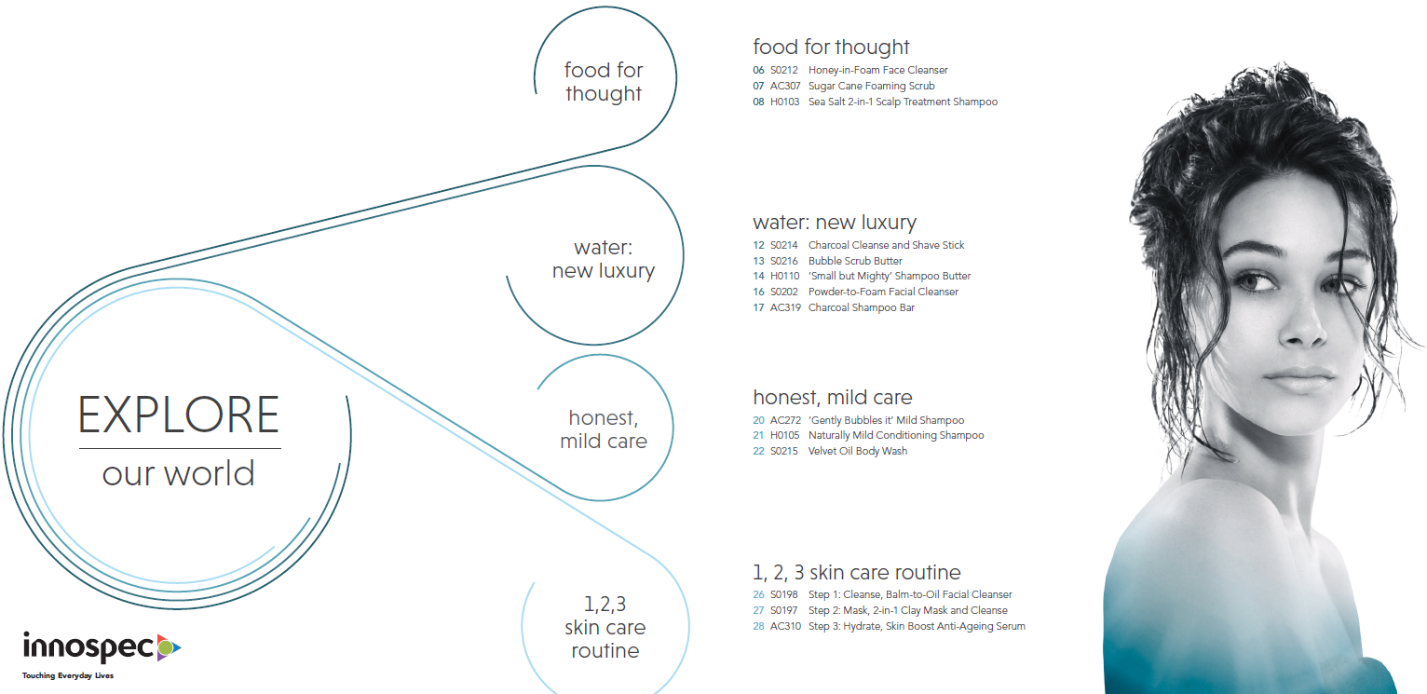
Sustainable formats in-cosmetics 2019

Slide 30
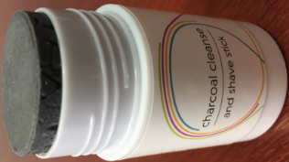
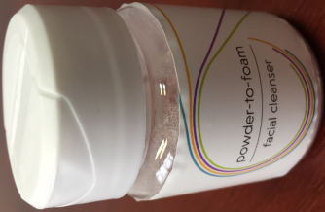
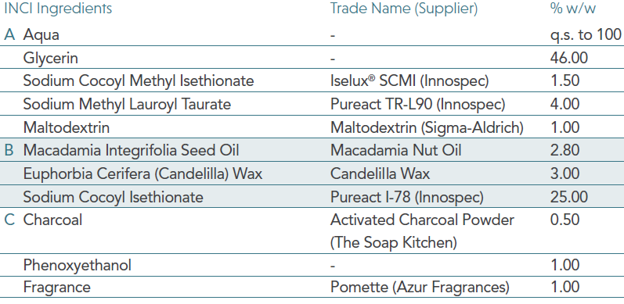
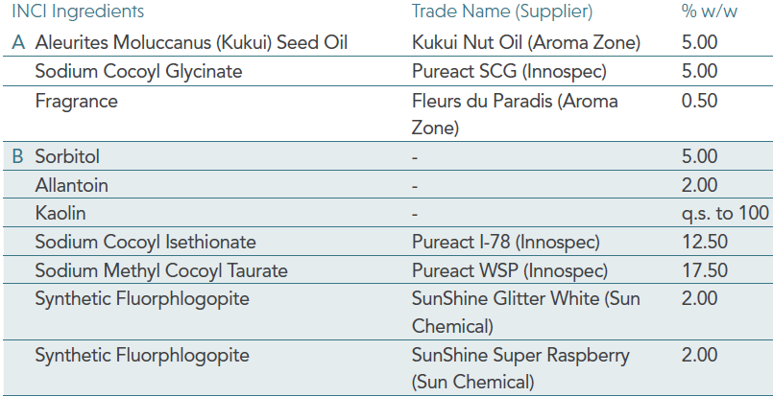
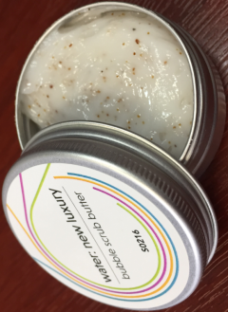
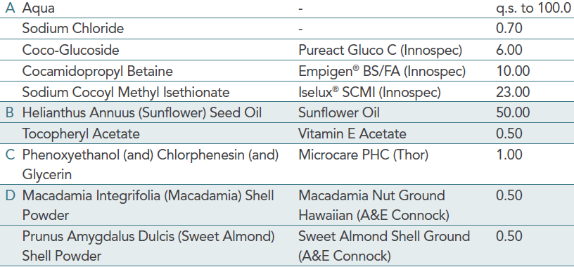
Sustainable formats
S0214 Charcoal
Cleanse and
Shave Stick
S0202 Powder-to-Foam
Facial Cleanser
S0216 Bubble Scrub Butter

Slide 31
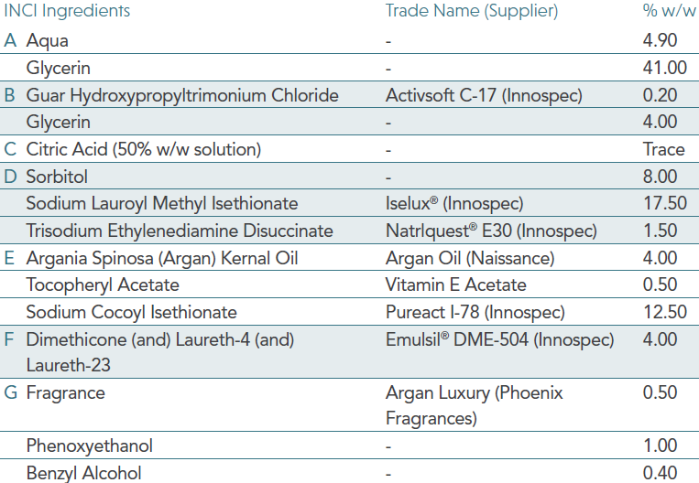
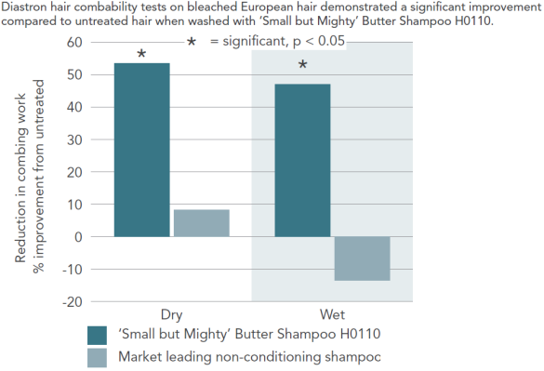
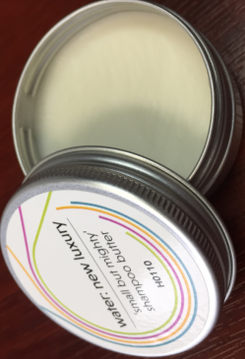
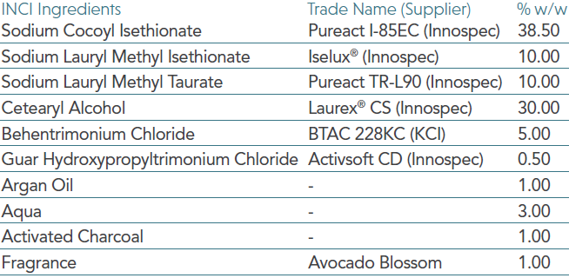
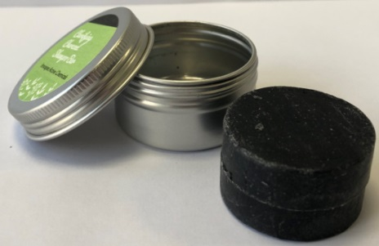
H0110 ‘Small but Mighty’
Shampoo Butter
Sustainable formats
AC 319 Charcoal
Shampoo Bar

Slide 32
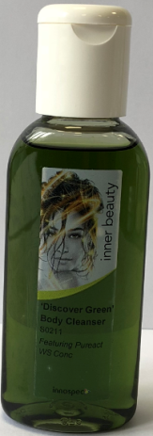
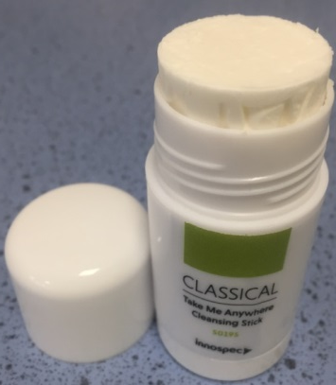
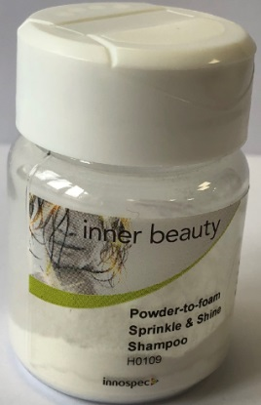
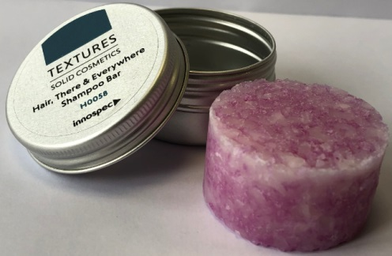
Sustainable formats
S0221 Cleansing Stick
Iselux® SCMI
S0211 ‘Discover Green’ Body Cleanser
Pureact WS Conc, Pureact Gluco L, Pureact MS-CG, Pureact LSR and Empigen® BS/FA – 95% Naturally Derived by ISO 16128
H0109 Powder-to-Foam Sprinkle
& Shine Shampoo
Pureact WSP, Pureact I-78, Pureact SCG and Activsoft C-13
H0113 Hair There and Everywhere
Compacted Shampoo Bar
Iselux® SCMI

Slide 33
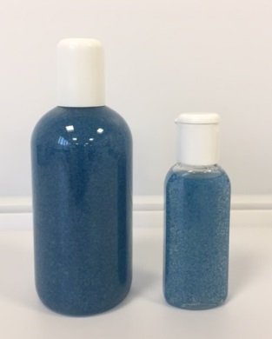
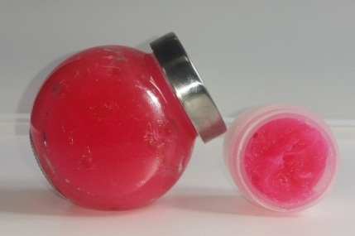
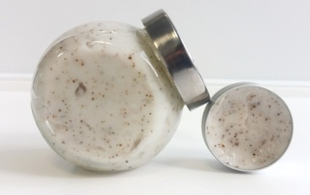
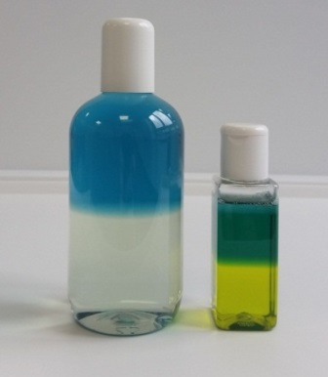
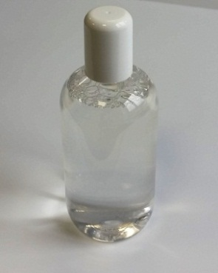
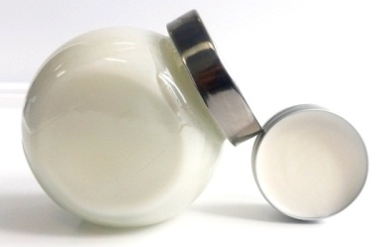
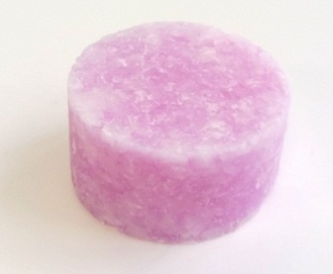
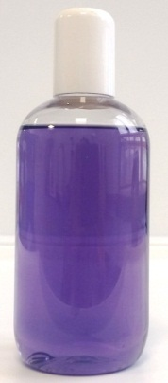
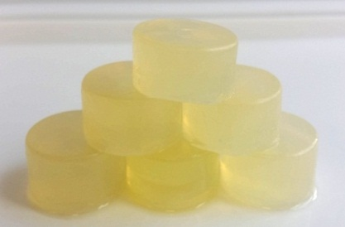
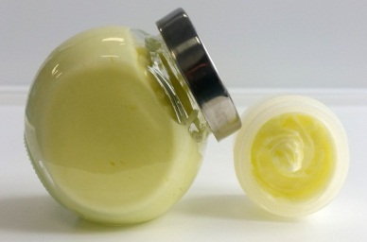
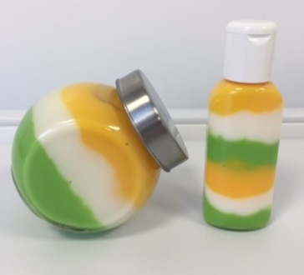
Interesting Formulations and Textures with Iselux®
Bubblegum Jelly Wash
S0172
Bubble Scrub Butter
S0132a
Shake, Shower and Shave Shower Gel
S0168
Gently Exfoliating Shower Gel
S0179
Ultra Mild Baby Bath Cleanser
AC235
Intensive care Argan oil cream shampoo
H0060
Micellar water
S0178
Good to Go,
Shampoo Bar
H0061
Trio of Oils Hair and
body Wash
S0128
Transparent Luxury Cleansing Bar
For Face and Body
S0152
Zesty Sorbet Scrub
S0119a

Slide 34
Summary
How to optimise formulations when using modern preservatives by careful choice of the surfactants used
Achieving stability
Achieving viscosity
Achieving clarity
Innospec are experts in sulfate-free formulating with world class popular surfactants.
We have overcome many of the challenges in sulfate-free formulating, optimising formulations to specific briefs to achieve:
Desired foaming performance
Stability
Viscosity with salt thickening or rheology modifiers
Clarity (or opacity)
Conditioning
We have a library of stable guide formulations which you can use as-is or as bases for your product development.
We can help you develop high-performing systems according to your briefs.
Please contact us to discuss how we can work together.

Slide 35
thank you for listening
please visit Innospec stand H88 for more information
tony.gough@innospecinc.com

