Slide 1

Silicones
Katarzyna Kłosowska

Slide 2

Boost your formula with cost-effective ingredients

Slide 3

Aqua Boost Cream
 | Ingredients | INCI | Dosage (%)
A1 | BRB 423 | Cetyl PEG/PPG-10/1 Dimethicone | 1.50
A2 | BRB 2835 | Cetyl Methicone | 1.00
A3 | BRB DM 10 | Dimethicone | 3.00
A4 | BRB CM 50 | Cyclopentasiloxane | 5.50
A5 | BRB SG 106 | Cyclopentasiloxane (and) Dimethicone/ Vinyl Dimethicone Crosspolymer | 2.00
B1 | DI Water | Aqua | 84.00
B2 | Salt | Sodium Chloride | 1.00
B3 | Propylene Glycol | Propylene Glycol | 2.00
C1 | Preservative |  | q.s
Notes:
Ogólne właściwości, zastosowanie,

Slide 4
Aqua Boost Cream
 | Ingredients | INCI | Dosage (%)
A1 | BRB 423 | Cetyl PEG/PPG-10/1 Dimethicone | 1.50
A2 | BRB 2835 | Cetyl Methicone | 1.00
A3 | BRB DM 10 | Dimethicone | 3.00
A4 | BRB CM 50 | Cyclopentasiloxane | 5.50
A5 | BRB SG 106 | Cyclopentasiloxane (and) Dimethicone/ Vinyl Dimethicone Crosspolymer | 2.00
B1 | DI Water | Aqua | 84.00
B2 | Salt | Sodium Chloride | 1.00
B3 | Propylene Glycol | Propylene Glycol | 2.00
C1 | Preservative |  | q.s
Notes:
Ogólne właściwości, zastosowanie,

Slide 5


Dimethicone Copolyols
Acts as wetting agent, emulsifier
Compatible with a wide range of cosmetic ingredients
Hair Care: Conditioning agent and superior non-oily feel
Skin Care & Color Cosmetics : Create non-comedogenic light
feel emulsions with elegant sensory
Smart
Ingredients

Slide 7
Aqua Boost Cream
 | Ingredients | INCI | Dosage (%)
A1 | BRB 423 | Cetyl PEG/PPG-10/1 Dimethicone | 1.50
A2 | BRB 2835 | Cetyl Methicone | 1.00
A3 | BRB DM 10 | Dimethicone | 3.00
A4 | BRB CM 50 | Cyclopentasiloxane | 5.50
A5 | BRB SG 106 | Cyclopentasiloxane (and) Dimethicone/ Vinyl Dimethicone Crosspolymer | 2.00
B1 | DI Water | Aqua | 84.00
B2 | Salt | Sodium Chloride | 1.00
B3 | Propylene Glycol | Propylene Glycol | 2.00
C1 | Preservative |  | q.s
Notes:
Ogólne właściwości, zastosowanie,

Slide 8
Alkyldimethicones
Boosters
BRB 2835: Cetyl dimethicone
BRB 2836: Stearyl dimethicone (and) Octadecene
BRB Caprylyl Methicone
Enhance sensory of natural ingredients, providing unique smooth silky feel
Organic compatibility, improve spreadability
Pigment compatibility, SPF booster
Water resistance
Applications : Hair Care, Body & Skin Care, Lip Care, Color Cosmetics and Sun Care

Slide 9
Volatile Profile of BRB Caprylyl Methicone
Moderate volatility- less dry feel compare to volatile silicones

Slide 10
Aqua Boost Cream
 | Ingredients | INCI | Dosage (%)
A1 | BRB 423 | Cetyl PEG/PPG-10/1 Dimethicone | 1.50
A2 | BRB 2835 | Cetyl Methicone | 1.00
A3 | BRB DM 10 | Dimethicone | 3.00
A4 | BRB CM 50 | Cyclopentasiloxane | 5.50
A5 | BRB SG 106 | Cyclopentasiloxane (and) Dimethicone/ Vinyl Dimethicone Crosspolymer | 2.00
B1 | DI Water | Aqua | 84.00
B2 | Salt | Sodium Chloride | 1.00
B3 | Propylene Glycol | Propylene Glycol | 2.00
C1 | Preservative |  | q.s
Notes:
Ogólne właściwości, zastosowanie,

Slide 11
Dimethicones
Cost-
Effective
BRB DM Fluid - Dimethicone 5 to 100.000 cSt
Outstanding emolliency and soft feel
Non Volatile
Excellent spreadability
Low viscosity dimethicones (5 – 20 cSt): miscible in organic ingredients
Skin Care, Antiperspirant & Deodorants, Sun Care, Hair Care and Color Cosmetics
Middle viscosity dimethicones (50 – 1.000 cSt): as oil additive
Skin Care, Antiperspirant & Deodorants, Sun Care, Hair Care and Color Cosmetics
High viscosity dimethicones (60.000 – 100.000 cSt): Exceptional conditioning agents in Hair Care products

Slide 12
Aqua Boost Cream
 | Ingredients | INCI | Dosage (%)
A1 | BRB 423 | Cetyl PEG/PPG-10/1 Dimethicone | 1.50
A2 | BRB 2835 | Cetyl Methicone | 1.00
A3 | BRB DM 10 | Dimethicone | 3.00
A4 | BRB CM 50 | Cyclopentasiloxane | 5.50
A5 | BRB SG 106 | Cyclopentasiloxane (and) Dimethicone/ Vinyl Dimethicone Crosspolymer | 2.00
B1 | DI Water | Aqua | 84.00
B2 | Salt | Sodium Chloride | 1.00
B3 | Propylene Glycol | Propylene Glycol | 2.00
C1 | Preservative |  | q.s
Notes:
Ogólne właściwości, zastosowanie,

Slide 13
Volatile Fluids
Cost-
Effective
Volatile on skin
Upon evaporation, impart soft, dry velvety feel,
no residue or build up
Make up: Volatile carrier in pigment dispersions
Aerosol: Replacement for organic solvent
      Reduce Stickiness
      Non clogging of nozzles
      No cooling effect on evaporation
Stick: Non tacky, apply without drag
Stick: Non tacky, apply without drag
Sunscreen: Solvent for actives, and dispersing aid for micronized oxides
Emulsions: Soft, smooth feel and pleasant application with a unique skin feel

Slide 14
Volatile Fluids
Cyclics Linears
REACH regulations
Wash-off cosmetics:
≥0.1% D4
≥0.1% D5
(adopted in Jan 2018, into force in Feb 2020)
Leave on cosmetics and all other profesional and consumer aplications:
≥0.1% D4
≥0.1% D5
(anticipated adoption in 2020)
DM 0.65 Disiloxane
DM 1 Trisiloxane
DM 1.5 Dimethicone
BRB 1417 Dimethicone (and) trisiloxane
DM 2 Dimethicone
DM 55 Dimethicone (alternative to Cyclopentasiloxane)
DM 66 Dimethicone
(alternative to Cyclopentasiloxane (and) Cyclohexasiloxane)
BRB CM 40 Cyclotetrasiloxane
BRB CM 50 Cyclopentasiloxane
BRB CM 60 Cyclohexasiloxane
BRB CM 45-S Cyclotetrasiloxane
(and) Cyclopentasiloxane
BRB CM 56-S Cyclopentasiloxane
(and) Cyclohexasiloxane

Slide 15
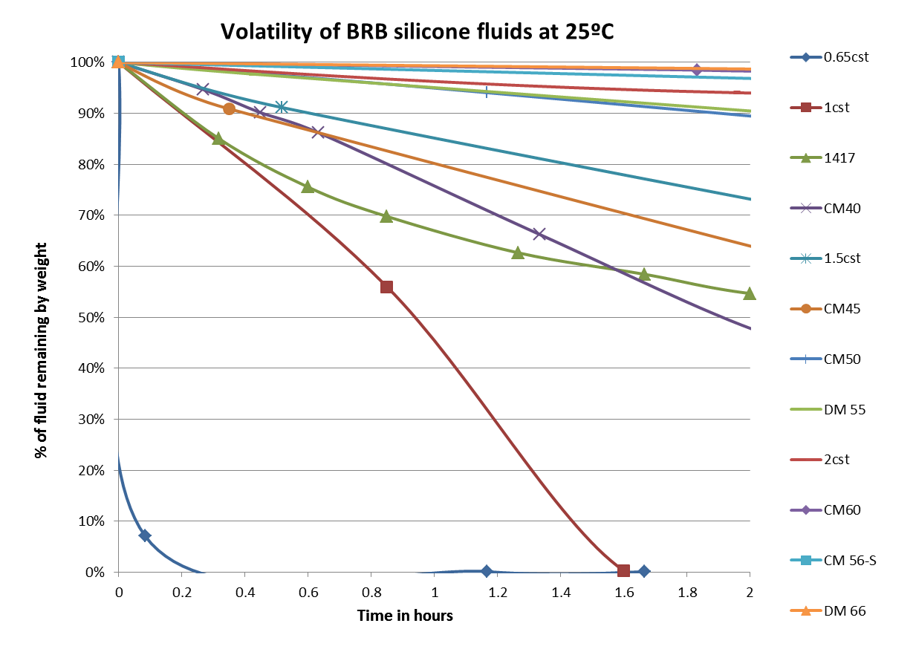
Volatile Fluids
Evaporation Characteristics

Slide 16
Aqua Boost Cream
 | Ingredients | INCI | Dosage (%)
A1 | BRB 423 | Cetyl PEG/PPG-10/1 Dimethicone | 1.50
A2 | BRB 2835 | Cetyl Methicone | 1.00
A3 | BRB DM 10 | Dimethicone | 3.00
A4 | BRB CM 50 | Cyclopentasiloxane | 5.50
A5 | BRB SG 106 | Cyclopentasiloxane (and) Dimethicone/ Vinyl Dimethicone Crosspolymer | 2.00
B1 | DI Water | Aqua | 84.00
B2 | Salt | Sodium Chloride | 1.00
B3 | Propylene Glycol | Propylene Glycol | 2.00
C1 | Preservative |  | q.s
Notes:
Ogólne właściwości, zastosowanie,

Slide 17
Silicone Crosspolymer
Silicone Fluid
Silicone Crosspolymer

Slide 18
Silicone Crosspolymer
Cyclopentasiloxane (and) Dimiethicone/Vinyl Dimethicone Crosspolymer
Dimethicone (and) Dimiethicone/Vinyl Dimethicone Crosspolymer
BRB SG 116
BRB SG 106
BRB SG 117
Viscosity
BRB SG 517
BRB SG 516
BRB SG 506
Crosspolymer content
After-feel intensity
Firmness
Wetness
Smoothness
Spreadability

Slide 19
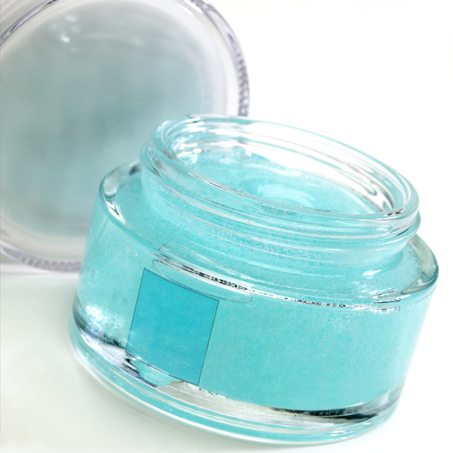
Silicone Crosspolymer
Impart superior sensory feel : smoothness, light, silky, non-greasy and
powdery touch
Cold Processable and Easy to formulate
Reduce tackiness of formulation
Acts as thickening agent, improving formula stability
Provide long-lasting effect
Applications : Skin Care, Hair Care, Antiperspirant & Deodorants, Color Cosmetics, Sunscreens and styling products
Boosters

Slide 20

CC Leave In Hair Conditioner

Slide 21
CC Leave In Hair Conditioner
 | Ingredients | INCI | Dosage (%)
A1 | DI Water | Aqua | 64.40
A2 | EDTA | Tetrasodium EDTA | 0.10
A3 | Glycerin | Glycerin | 2.00
A4 | Genamin KDMP | Behentrimonium Chloride | 1.50
B1 | Cosmowax D | Cetearyl Alcohol (and) Ceteareth-20 | 4.00
B2 | BRB DM 100 | Dimethicone | 3.00
B3 | BRB PTM 20 | Phenyl Trimethicone | 2.00
B4 | Evoil Hair PT | Glycine Soja Oil (and) Helianthus annuus Seed Oil (and) Olea Europaea Fruit Oil (and) Triticum Vulgare Germ Oil (and) Panthenyl Triacetate (and) Tocopherol. | 2.00
B5 | BRB 1855/ BRB 1834 | Cyclopentasiloxane (and) Dimethiconol | 1.50
C1 | BRB CM 56-S | Cyclopentasiloxane (and) Cyclohexasiloxane | 3.00
C2 | D-Panthenol | Panthenol | 0.50
C3 | BRB 5446 | Silicone Quaternium-17 (and) Trideceth-7 (and) Trideceth-5 | 2.00
C4 | BRB TMS-50C | Cyclopentasiloxane (and) Trimethylsiloxysilicate | 1.00
D1 | DI Water | Aqua | 10.00
D2 | PVP VA 64 | VP/VA Copolymer | 1.50
E1 | Viscaress HPD | Polyquaternium-37 (and) Hydrogenated Polydecene (and) and Trideceth-6 (and) Water (aqua) | 0.50
E2 | Euxyl PE 9010 | Phenoxyethanol (and) Ethylhexylglycerin | 1.00
E3 | Perfume | Parfume | q.s
E4 | Citric Acid | Citric Acid | q.s

Slide 22
Phenyl Modified Fluid
BRB PTM 20 - Phenyl Trimethicone
High refractive Index which imparts gloss
Good solubility or compatibility with many organic ingredients
Excellent emolliency and reduced tackiness
Widely used in Color Cosmetics, Hair Care, Skin Care and Sunscreens
Cost-Effective
Booster

Slide 23
CC Leave In Hair Conditioner
 | Ingredients | INCI | Dosage (%)
A1 | DI Water | Aqua | 64.40
A2 | EDTA | Tetrasodium EDTA | 0.10
A3 | Glycerin | Glycerin | 2.00
A4 | Genamin KDMP | Behentrimonium Chloride | 1.50
B1 | Cosmowax D | Cetearyl Alcohol (and) Ceteareth-20 | 4.00
B2 | BRB DM 100 | Dimethicone | 3.00
B3 | BRB PTM 20 | Phenyl Trimethicone | 2.00
B4 | Evoil Hair PT | Glycine Soja Oil (and) Helianthus annuus Seed Oil (and) Olea Europaea Fruit Oil (and) Triticum Vulgare Germ Oil (and) Panthenyl Triacetate (and) Tocopherol. | 2.00
B5 | BRB 1855/ BRB 1834 | Cyclopentasiloxane (and) Dimethiconol | 1.50
C1 | BRB CM 56-S | Cyclopentasiloxane (and) Cyclohexasiloxane | 3.00
C2 | D-Panthenol | Panthenol | 0.50
C3 | BRB 5446 | Silicone Quaternium-17 (and) Trideceth-7 (and) Trideceth-5 | 2.00
C4 | BRB TMS-50C | Cyclopentasiloxane (and) Trimethylsiloxysilicate | 1.00
D1 | DI Water | Aqua | 10.00
D2 | PVP VA 64 | VP/VA Copolymer | 1.50
E1 | Viscaress HPD | Polyquaternium-37 (and) Hydrogenated Polydecene (and) and Trideceth-6 (and) Water (aqua) | 0.50
E2 | Euxyl PE 9010 | Phenoxyethanol (and) Ethylhexylglycerin | 1.00
E3 | Perfume | Parfume | q.s
E4 | Citric Acid | Citric Acid | q.s

Slide 24
Gum blends
BRB 1735 Cyclopentasiloxane (and) Cyclotetrasiloxane (and) Dimethiconol
BRB 1744, 1755 Cyclotetrasiloxane (and) Cyclopentasiloxane (and) Dimethiconol
BRB 1834, 1934 Cyclopentasiloxane (and) Dimethiconol
BRB 1844 Cyclopentasiloxane (and) Dimethicone
BRB 1736, 1740, Dimethicone (and) Dimethiconol
BRB 1860
Custom made on request
Applications Body & Skin Care, Antiperspirant & Deodorants, Sunscreen Products, Color Cosmetics and Hair Care

Slide 25
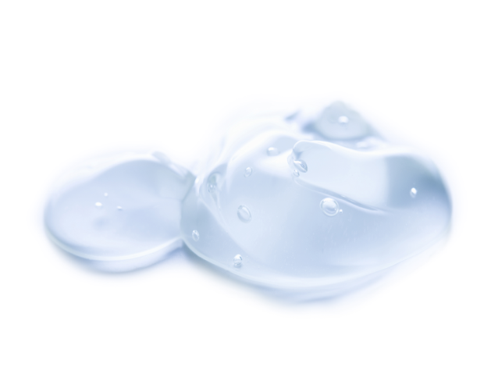
Gum blends
Impart emollience to skin, providing lubricious and silky feel
Give spreadability to any kind of formula
Provide a breathable non-comedogenic protection barrier
Improve substantivity on surface, helping to fix other actives
Long lasting effect
Water resistance supply on skin and hair, with non-occlusive film
Yield shine and high conditioning effect on hair

Slide 26
CC Leave In Hair Conditioner
 | Ingredients | INCI | Dosage (%)
A1 | DI Water | Aqua | 64.40
A2 | EDTA | Tetrasodium EDTA | 0.10
A3 | Glycerin | Glycerin | 2.00
A4 | Genamin KDMP | Behentrimonium Chloride | 1.50
B1 | Cosmowax D | Cetearyl Alcohol (and) Ceteareth-20 | 4.00
B2 | BRB DM 100 | Dimethicone | 3.00
B3 | BRB PTM 20 | Phenyl Trimethicone | 2.00
B4 | Evoil Hair PT | Glycine Soja Oil (and) Helianthus annuus Seed Oil (and) Olea Europaea Fruit Oil (and) Triticum Vulgare Germ Oil (and) Panthenyl Triacetate (and) Tocopherol. | 2.00
B5 | BRB 1855/ BRB 1834 | Cyclopentasiloxane (and) Dimethiconol | 1.50
C1 | BRB CM 56-S | Cyclopentasiloxane (and) Cyclohexasiloxane | 3.00
C2 | D-Panthenol | Panthenol | 0.50
C3 | BRB 5446 | Silicone Quaternium-17 (and) Trideceth-7 (and) Trideceth-5 | 2.00
C4 | BRB TMS-50C | Cyclopentasiloxane (and) Trimethylsiloxysilicate | 1.00
D1 | DI Water | Aqua | 10.00
D2 | PVP VA 64 | VP/VA Copolymer | 1.50
E1 | Viscaress HPD | Polyquaternium-37 (and) Hydrogenated Polydecene (and) and Trideceth-6 (and) Water (aqua) | 0.50
E2 | Euxyl PE 9010 | Phenoxyethanol (and) Ethylhexylglycerin | 1.00
E3 | Perfume | Parfume | q.s
E4 | Citric Acid | Citric Acid | q.s

Slide 27
BRB Personal Care Emulsions
Cost-
Effective
Hair Care and Skin Care applications
Emulsions of silicone for easy formulation into hair treatment products
Concentration easily adjusted by dilution with water
Protective coating upon drying
Imparts soft and silky feel
Improves wet and dry combing

Slide 29
CC Leave In Hair Conditioner
 | Ingredients | INCI | Dosage (%)
A1 | DI Water | Aqua | 64.40
A2 | EDTA | Tetrasodium EDTA | 0.10
A3 | Glycerin | Glycerin | 2.00
A4 | Genamin KDMP | Behentrimonium Chloride | 1.50
B1 | Cosmowax D | Cetearyl Alcohol (and) Ceteareth-20 | 4.00
B2 | BRB DM 100 | Dimethicone | 3.00
B3 | BRB PTM 20 | Phenyl Trimethicone | 2.00
B4 | Evoil Hair PT | Glycine Soja Oil (and) Helianthus annuus Seed Oil (and) Olea Europaea Fruit Oil (and) Triticum Vulgare Germ Oil (and) Panthenyl Triacetate (and) Tocopherol. | 2.00
B5 | BRB 1855/ BRB 1834 | Cyclopentasiloxane (and) Dimethiconol | 1.50
C1 | BRB CM 56-S | Cyclopentasiloxane (and) Cyclohexasiloxane | 3.00
C2 | D-Panthenol | Panthenol | 0.50
C3 | BRB 5446 | Silicone Quaternium-17 (and) Trideceth-7 (and) Trideceth-5 | 2.00
C4 | BRB TMS-50C | Cyclopentasiloxane (and) Trimethylsiloxysilicate | 1.00
D1 | DI Water | Aqua | 10.00
D2 | PVP VA 64 | VP/VA Copolymer | 1.50
E1 | Viscaress HPD | Polyquaternium-37 (and) Hydrogenated Polydecene (and) and Trideceth-6 (and) Water (aqua) | 0.50
E2 | Euxyl PE 9010 | Phenoxyethanol (and) Ethylhexylglycerin | 1.00
E3 | Perfume | Parfume | q.s
E4 | Citric Acid | Citric Acid | q.s

Slide 30

Silicone resins
BRB TMS Trimethylsiloxysilicate
BRB TMS-50C Cyclopentasiloxane (and) Trimethylsiloxysilicate
BRB TMS-30D Dimethicone (and) Trimethylsiloxysilicate
BRB TMS-50I Isododecane (and) Trimethylsiloxysilicate
BRB Color Lock Isododecane (and) Trimethylsiloxysilicate (and) Dimethicone
Custom made
Excellent film former, providing long lasting effect
Wash-off and rub-off resistant
Unique smooth non-tacky feel
New

Slide 31
Silicone resins
Boosters
BRB PMS-2 / BRB PMS-5 Polymethylsilsesquioxane
Soft focus effect, reduction of fine lines and wrinkles
Luxurious smooth dry feel
Excellent lubricity, due to ball bearing effect
Prevention of pigment and powder agglomeration
Sebum absorption
Water repellence improvement
Applications : Skin Care and Color cosmetics

Slide 32
Silicones
Cost-
Effective
Boosters
Smart
Ingredients

Slide 33
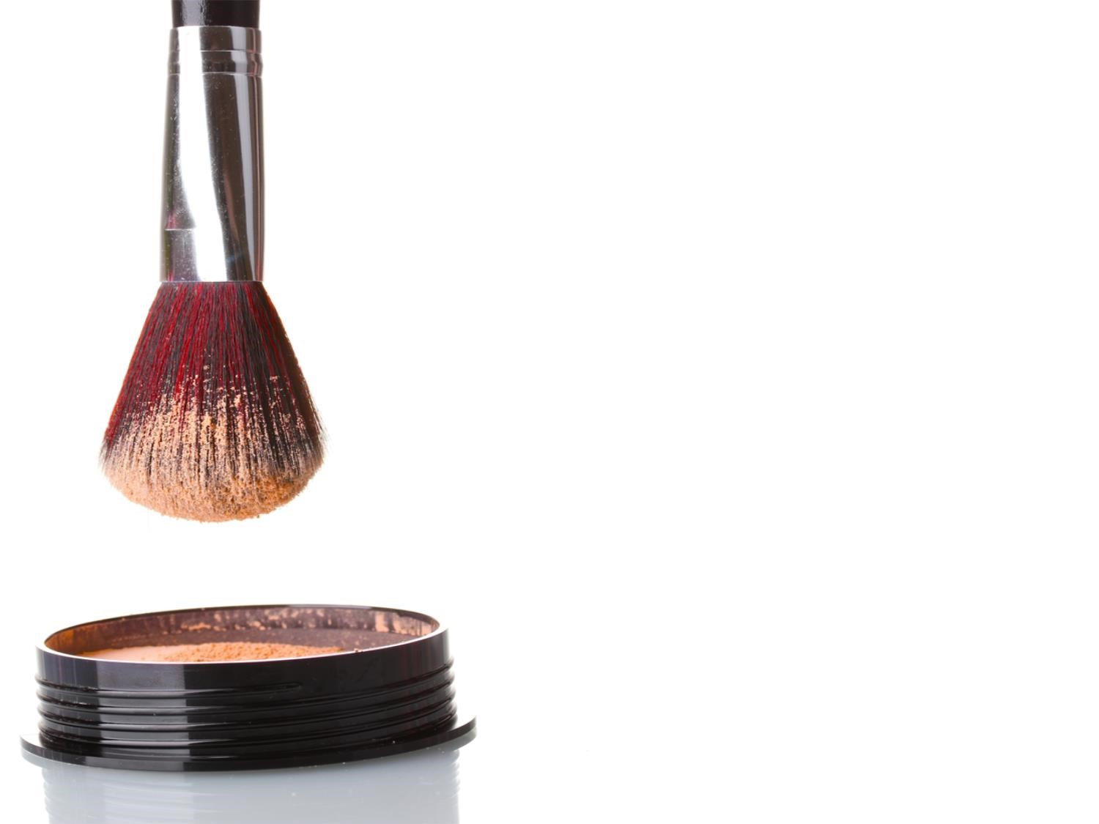
BRB Personal Care
BRB Personal Care
We would like to offer you:
Greater flexibility
A wide range of products
Worldwide coverage
We would like to offer you:
Greater flexibility
A wide range of products
Worldwide coverage
We are:
Highly experienced in tailor made solutions
Highly experienced in toll manufacturing
We are:
Highly experienced in tailor made solutions
Highly experienced in toll manufacturing

Slide 34


